Slide 1
What is the AWS Well-Architected Framework?
A guide for designing infrastructures that are:
Secure
High-performing
Resilient
Efficient
A consistent approach to evaluating and implementing cloud architectures
A way to provide best practices that were developed through lessons learned by reviewing customer architectures
Notes:
The AWS Well-Architected Framework is a guide that is designed to help you build the most secure, high-performing, resilient, and efficient infrastructure possible for your cloud applications and workloads. It provides a set of foundational questions and best practices that can help you evaluate and implement your cloud architectures. AWS developed the Well-Architected Framework after reviewing thousands of customer architectures on AWS.

Slide 2
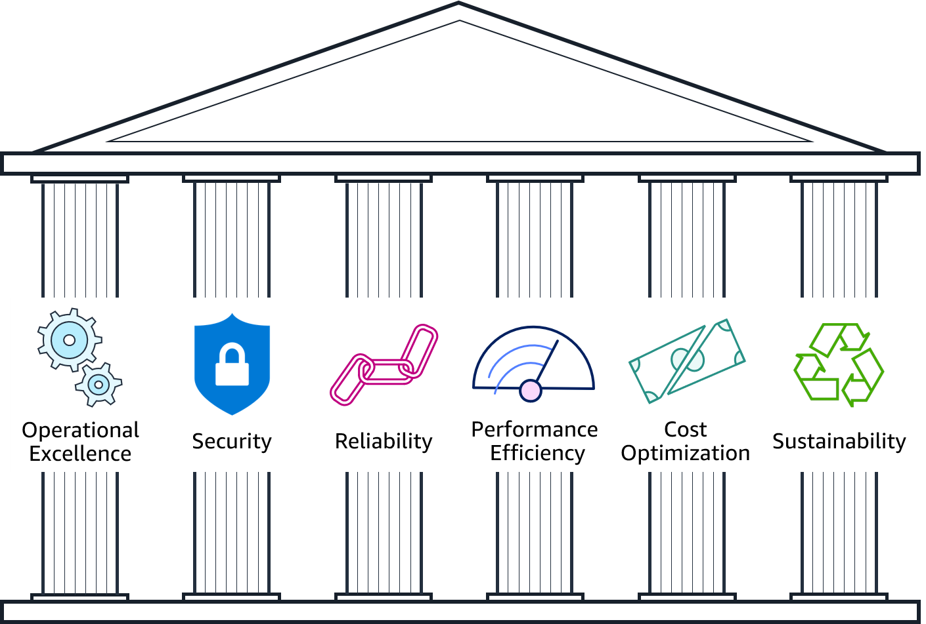
Pillars of the AWS Well-Architected Framework
Notes:
The AWS Well-Architected Framework is organized into six pillars: operational excellence, security, reliability, performance efficiency, cost optimization, and sustainability. The first five pillars have been part of the framework since the framework's introduction in 2015. The sustainability pillar was added as the sixth pillar in 2021 to help organizations learn how to minimize the environmental impacts of running cloud workloads.
The remainder of this module focuses on the first five pillars (operational excellence, security, reliability, performance efficiency, cost optimization) and leads you through a review of an example architecture against each pillar's design principles.
For more about the sustainability pillar, refer to the sustainability pillar section within the Well-Architected Framework documentation see https://docs.aws.amazon.com/wellarchitected/latest/sustainability-pillar/sustainability-pillar.html.
For accessibility: The pillars include operational excellence, security, reliability, performance efficiency, cost optimization, and sustainability. End of accessibility description.

Slide 3
Pillar organization
Best practice area
Identity and Access Management
SEC 1: How do you manage credentials and authentication?
Credential and authentication mechanisms include passwords, tokens, and keys that grant access directly or indirectly in your workload. Protect credentials with appropriate mechanisms to help reduce the risk of accidental or malicious use.
Best practices:
Define requirements for identity and access management
Secure AWS account root user
Enforce use of multi-factor authentication
Automate enforcement of access controls
Integrate with centralized federation provider
Enforce password requirements
Rotate credentials regularly
Audit credentials periodically
Question text
Question context
Best practices
Notes:
Each pillar includes a set of design principles and best practice areas. Each best practice area aligns to questions a reviewer should ask when designing an architecture. The questions for each pillar are part of the Well-Architected Framework Appendix.

Slide 4
Operational Excellence pillar
Notes:
Operational Excellence pillar

Slide 5

Operational Excellence pillar – deliver business value
Operational Excellence
pillar
Focus
Run and monitor systems to deliver business value, and to continually improve supporting processes and procedures.
Key topics
Automating changes
Responding to events
Defining standards to manage daily operations
Deliver business value
Notes:
The Operational Excellence pillar focuses on the ability to run and monitor systems to deliver business value, and to continually improve supporting processes and procedures. Key topics include: automating changes, responding to events, and defining standards to manage daily operations.

Slide 6
Operational excellence design principles
Operational Excellence
pillar
Perform operations as code
Make frequent, small, reversible changes
Refine operations procedures frequently
Anticipate failure
Learn from all operational events and failures
Deliver business value
Notes:
There are five design principles for operational excellence in the cloud:
Perform operations as code – Define your entire workload (that is, applications and infrastructure) as code and update it with code. Implement operations procedures as code and configure them to automatically trigger in response to events. By performing operations as code, you limit human error and enable consistent responses to events.
Make frequent, small, reversible changes – Design workloads to enable components to be updated regularly. Make changes in small increments that can be reversed if they fail (without affecting customers when possible).
Refine operations procedures frequently – Look for opportunities to improve operations procedures. Evolve your procedures appropriately as your workloads evolve. Set up regular game days to review all procedures, validate their effectiveness, and ensure that teams are familiar with them.
Anticipate failure – Identify potential sources of failure so that they can be removed or mitigated. Test failure scenarios and validate your understanding of their impact. Test your response procedures to ensure that they are effective and that teams know how to run them. Set up regular game days to test workloads and team responses to simulated events.
Learn from all operational failures – Drive improvement through lessons learned from all operational events and failures. Share what is learned across teams and through the entire organization.

Slide 7
Security pillar
Notes:
Security pillar

Slide 8

Security pillar – protect and monitor systems
Security
pillar
Focus
Protect information, systems, and assets while delivering business value through risk assessments and mitigation strategies.
Key topics
Protecting confidentiality and integrity of data
Identifying and managing who can do what
Protecting systems
Establishing controls to detect security events
Protect and monitor systems
Notes:
The Security pillar focuses on the ability to protect information, systems, and assets while delivering business value through risk assessments and mitigation strategies. Key topics include: protecting confidentiality and integrity of data, identifying and managing who can do what (or privilege management), protecting systems, and establishing controls to detect security events.

Slide 9
Security design principles
Security
pillar
Implement a strong identity foundation
Enable traceability
Apply security at all layers
Automate security best practices
Protect data in transit and at rest
Keep people away from data
Prepare for security events
Protect and monitor systems
Notes:
There are seven design principles that can improve security:
Implement a strong identity foundation – Implement the principle of least privilege and enforce separation of duties with appropriate authorization for each interaction with your AWS resources. Centralize privilege management and reduce or even eliminate reliance on long-term credentials.
Enable traceability – Monitor, alert, and audit actions and changes to your environment in real time. Integrate logs and metrics with systems to automatically respond and take action.
Apply security at all layers – Apply defense in depth and apply security controls to all layers of your architecture (for example, edge network, virtual private cloud, subnet, and load balancer; and every instance, operating system, and application).
Automate security best practices – Automate security mechanisms to improve your ability to securely scale more rapidly and cost effectively. Create secure architectures and implement controls that are defined and managed as code in version-controlled templates.
Protect data in transit and at rest – Classify your data into sensitivity levels and use mechanisms such as encryption, tokenization, and access control where appropriate.
Keep people away from data – To reduce the risk of loss or modification of sensitive data due to human error, create mechanisms and tools to reduce or eliminate the need for direct access or manual processing of data.
Prepare for security events – Have an incident management process that aligns with organizational requirements. Run incident response simulations and use tools with automation to increase your speed of detection, investigation, and recovery.

Slide 10
Reliability pillar
Notes:
Reliability pillar

Slide 11

Reliability pillar – recover from failure and mitigate disruption
Reliability
pillar
Focus
Ensure a workload performs its intended function correctly and consistently when it’s expected to.
Key topics
Designing distributed systems
Recovery planning
Handling change
Recover from failure and mitigate disruption.
Notes:
The Reliability pillar focuses on ensuring a workload performs its intended function correctly and consistently when it’s expected to. A resilient workload quickly recovers from failures to meet business and customer demand. Key topics include: designing distributed systems, recovery planning, and handling change.

Slide 12
Reliability design principles
Reliability
pillar
Automatically recover from failure
Test recovery procedures
Scale horizontally to increase aggregate workload availability
Stop guessing capacity
Manage change in automation
Recover from failure and mitigate disruption.
Notes:
There are five design principles that can increase reliability:
Automatically recover from failure – Monitor systems for key performance indicators and configure your systems to trigger an automated recovery when a threshold is breached. This practice enables automatic notification and failure-tracking, and for automated recovery processes that work around or repair the failure.
Test recovery procedures – Test how your systems fail and validate your recovery procedures. Use automation to simulate different failures or to recreate scenarios that led to failures before. This practice can expose failure pathways that you can test and rectify before a real failure scenario.
Scale horizontally to increase aggregate workload availability – Replace one large resource with multiple, smaller resources and distribute requests across these smaller resources to reduce the impact of a single point of failure on the overall system.
Stop guessing capacity – Monitor demand and system usage, and automate the addition or removal of resources to maintain the optimal level for satisfying demand.
Manage change in automation – Use automation to make changes to infrastructure and manage changes in automation.

Slide 13
Performance Efficiency pillar
Notes:
Performance Efficiency pillar

Slide 14

Performance Efficiency pillar – use resources sparingly
Performance Efficiency
pillar
Focus
Use IT and computing resources efficiently to meet system requirements and to maintain that efficiency as demand changes and technologies evolve.
Key topics
Selecting the right resource types and sizes based on workload requirements
Monitoring performance
Making informed decisions to maintain efficiency as business needs evolve
Use resources sparingly.
Notes:
The Performance Efficiency pillar focuses on the ability to use IT and computing resources efficiently to meet system requirements, and to maintain that efficiency as demand changes or technologies evolve. Key topics include: selecting the right resource types and sizes based on workload requirements, monitoring performance, and making informed decisions to maintain efficiency as business needs evolve.

Slide 15
Performance efficiency design principles
Performance Efficiency
pillar
Democratize advanced technologies
Go global in minutes
Use serverless architectures
Experiment more often
Consider mechanical sympathy
Use resources sparingly.
Notes:
There are five design principles that can improve performance efficiency:
Democratize advanced technologies – Consume technologies as a service. For example, technologies such as NoSQL databases, media transcoding, and machine learning require expertise that is not evenly dispersed across the technical community. In the cloud, these technologies become services that teams can consume. Consuming technologies enables teams to focus on product development instead of resource provisioning and management.
Go global in minutes – Deploy systems in multiple AWS Regions to provide lower latency and a better customer experience at minimal cost.
Use serverless architectures – Serverless architectures remove the operational burden of running and maintaining servers to carry out traditional compute activities. Serverless architectures can also lower transactional costs because managed services operate at cloud scale.
Experiment more often – Perform comparative testing of different types of instances, storage, or configurations.
Consider mechanical sympathy – Use the technology approach that aligns best to what you are trying to achieve. For example, consider your data access patterns when you select approaches for databases or storage.

Slide 16
Cost Optimization pillar
Notes:
Cost Optimization pillar

Slide 17

Cost Optimization pillar – eliminate unneeded expense
Cost Optimization pillar
Focus
Avoid unnecessary costs.
Key topics
Understanding and controlling where money is being spent
Selecting the most appropriate and right number of resource types
Analyzing spend over time
Scaling to meeting business needs without overspending
Eliminate unneeded expense.
Notes:
The Cost Optimization pillar focuses on the ability to avoid unnecessary costs. Key topics include: understanding and controlling where money is being spent, selecting the most appropriate and right number of resource types, analyzing spend over time, and scaling to meeting business needs without overspending.

Slide 18
Cost optimization design principles
Cost Optimization pillar
Implement Cloud Financial Management
Adopt a consumption model
Measure overall efficiency
Stop spending money on undifferentiated heavy lifting
Analyze and attribute expenditure
Eliminate unneeded expense.
Notes:
There are five design principles that can optimize costs:
Implement Cloud Financial Management – To achieve financial success and accelerate business value realization in the cloud, you need to invest in cloud financial management and cost optimization. You need to build capability through knowledge building, programs, resources, and processes to become a cost-efficient organization.
Adopt a consumption model – Pay only for the computing resources that you require. Increase or decrease usage depending on business requirements, not by using elaborate forecasting.
Measure overall efficiency – Measure the business output of the workload and the costs that are associated with delivering it. Use this measure to know the gains that you make from increasing output and reducing costs.
Stop spending money on undifferentiated heavy lifting – AWS does the heavy lifting of racking, stacking, and powering servers, which means that you can focus on your customers and business projects instead of the IT infrastructure.
Analyze and attribute expenditure – The cloud makes it easier to accurately identify system usage and costs, and attribute IT costs to individual workload owners. Having this capability helps you measure return on investment (ROI) and gives workload owners an opportunity to optimize their resources and reduce costs.

Slide 19
The AWS Well-Architected Tool
Helps you review the state of your workloads and compares them to the latest AWS architectural best practices
Gives you access to knowledge and best practices used by AWS architects, whenever you need it
Delivers an action plan with step-by-step guidance on how to build better workloads for the cloud
Provides a consistent process for you to review and measure your cloud architectures
Notes:
The activity that you just completed is similar to how you would use the AWS Well-Architected Tool.
The AWS Well-Architected Tool helps you review the state of your workloads and compare them to the latest AWS architectural best practices. It gives you access to knowledge and best practices used by AWS architects, whenever you need it.
This tool is available in the AWS Management Console. You define your workload and answer a series of questions in the areas of operational excellence, security, reliability, performance efficiency, and cost optimization (as defined in the AWS Well-Architected Framework). The AWS Well-Architected Tool then delivers an action plan with step-by-step guidance on how to improve your workload for the cloud.
The AWS Well-Architected Tool provides a consistent process for you to review and measure your cloud architectures. You can use the results that the tool provides to identify next steps for improvement, drive architectural decisions, and bring architecture considerations into your corporate governance process.

Slide 20
Reliability
A measure of your system’s ability to provide functionality when desired by the user.
System includes all system components: hardware, firmware, and software.
Probability that your entire system will function as intended for a specified period.
Mean time between failures (MTBF) = total time in service/number of failures
Car
Brakes
System Component
Ignition
Cooling
System
Component
System component
System
Notes:
Reliability is a measure of your system’s ability to provide functionality when desired by the user. Because "everything fails, all the time," you should think of reliability in statistical terms. Reliability is the probability that an entire system will function as intended for a specified period. Note that a system includes all system components, such as hardware, firmware, and software. Failure of system components impacts the availability of the system.
To understand reliability, it is helpful to consider the familiar example of a car. The car is the system. Each of the car’s components (for example, cooling, ignition, and brakes) must work together in order for the car to work properly. If you try to start the car and the ignition fails, you cannot drive anywhere—the car is not available. If the ignition fails repeatedly, your car is not considered reliable.
A common way to measure reliability is to use statistical measurements, such as Mean Time Between Failures (MTBF). MTBF is the total time in service over the number of failures.

Slide 21
Factors that influence availability
Fault tolerance
The built-in redundancy of an application's components and its ability to remain operational.
Scalability
The ability of an application to accommodate increases in capacity needs without changing design.
Recoverability
The process, policies, and procedures that are related to restoring service after a catastrophic event.
Notes:
Though events that might disrupt an application’s availability cannot always be predicted, you can build availability into your architecture design. There are three factors that determine the overall availability of your application:
Fault tolerance refers to the built-in redundancy of an application's components and the ability of the application to remain operational even if some of its components fail. Fault tolerance relies on specialized hardware to detect failure in a system component (such as a processor, memory board, power supply, I/O subsystem, or storage subsystem) and instantaneously switch to a redundant hardware component. The fault-tolerant model does not address software failures, which are the most common reason for downtime.
Scalability is the ability of your application to accommodate increases in capacity needs, remain available, and perform within your required standards. It does not guarantee availability, but it contributes to your application's availability.
Recoverability is the ability to restore service quickly and without lost data if a disaster makes your components unavailable, or it destroys data.
Keep in mind that improving availability usually leads to increased cost. When you consider how to make your environment more available, it's important to balance the cost of the improvement with the benefit to your users.
Do you want to ensure that your application is always alive or reachable, or do you want to ensure that it is servicing requests within an acceptable level of performance?

Slide 22

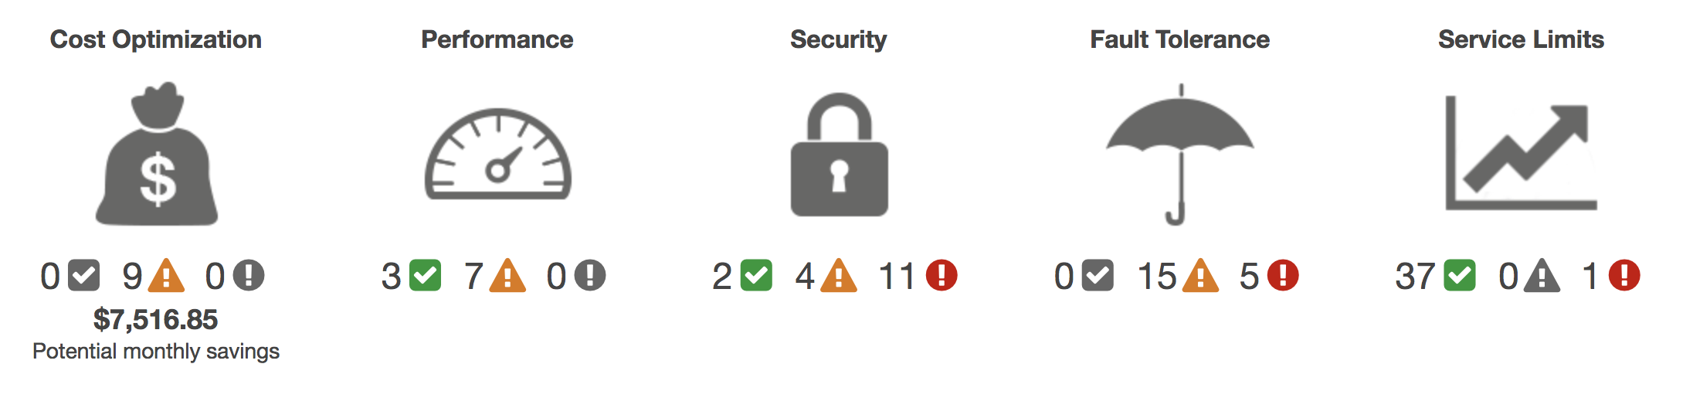
AWS Trusted Advisor
Online tool that provides real-time guidance to help you provision your resources following AWS best practices.
Looks at your entire AWS environment and gives you real-time recommendations in five categories.
AWS Trusted Advisor
Cost Optimization
Performance
Security
Fault Tolerance
Service Limits
Potential monthly savings
Notes:
AWS Trusted Advisor is an online tool that provides real-time guidance to help you provision your resources following AWS best practices.
AWS Trusted Advisor looks at your entire AWS environment and gives you recommendations in five categories:
Cost Optimization – AWS Trusted Advisor looks at your resource use and makes recommendations to help you optimize cost by eliminating unused and idle resources, or by making commitments to reserved capacity.
Performance – Improve the performance of your service by checking your service limits, ensuring you take advantage of provisioned throughput, and monitoring for overutilized instances.
Security – Improve the security of your application by closing gaps, enabling various AWS security features, and examining your permissions.
Fault Tolerance – Increase the availability and redundancy of your AWS application by taking advantage of automatic scaling, health checks, Multi-AZ deployments, and backup capabilities.
Service Limits – AWS Trusted Advisor checks for service usage that is more than 80 percent of the service limit. Values are based on a snapshot, so your current usage might differ. Limit and usage data can take up to 24 hours to reflect any changes.
For a detailed description of the information that AWS Trusted Advisor provides, see AWS Trusted Advisor Best Practice Checks at https://docs.aws.amazon.com/awssupport/latest/user/trusted-advisor-check-reference.html.

Slide 23
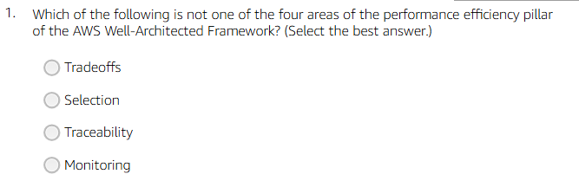
Notes:
3

Slide 24
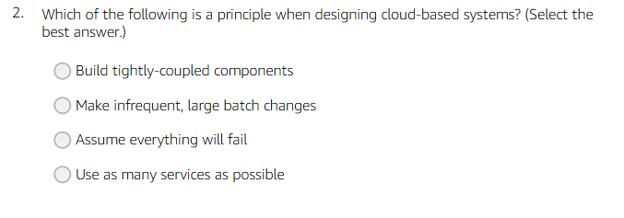
Notes:
2

Slide 25
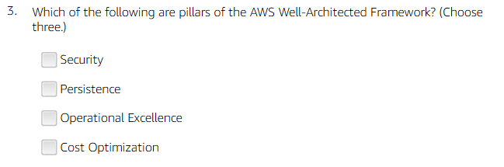
Notes:
1,3,4

Slide 26
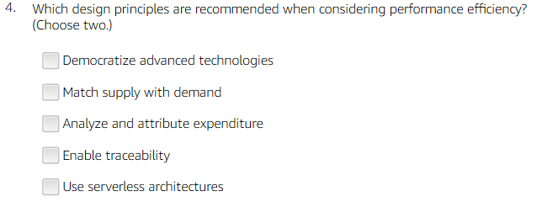
Notes:
1,5

Slide 27
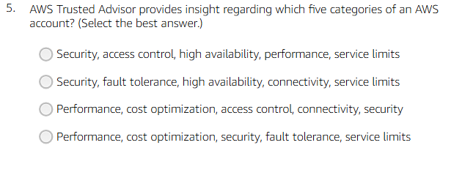
Notes:
4

Slide 28
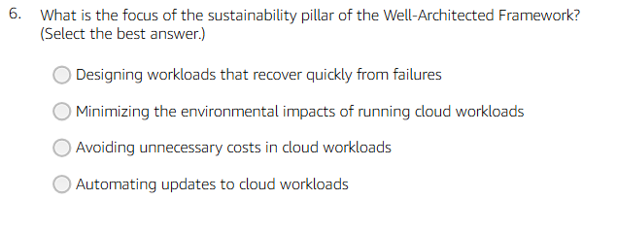
Notes:
2

Slide 29
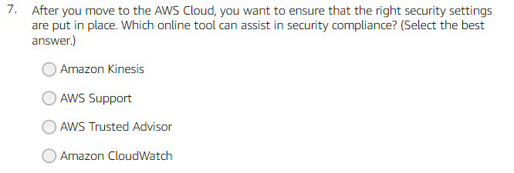
Notes:
3

Slide 30
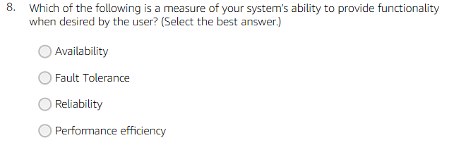
Notes:
3

Slide 31
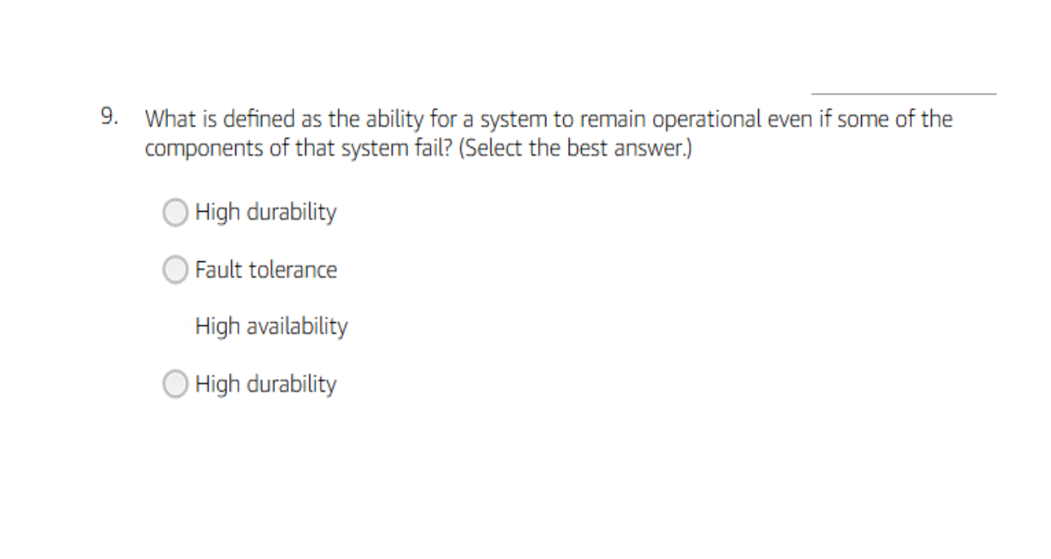
Notes:
2

Slide 32

Notes:
4

Slide 33
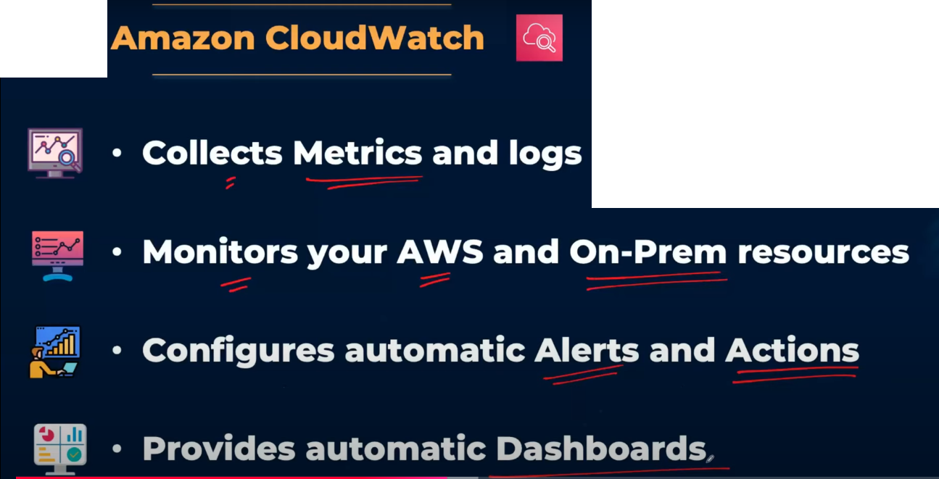

Slide 34
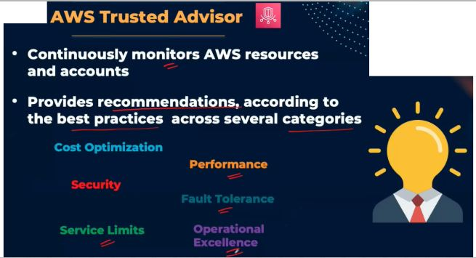

Slide 35
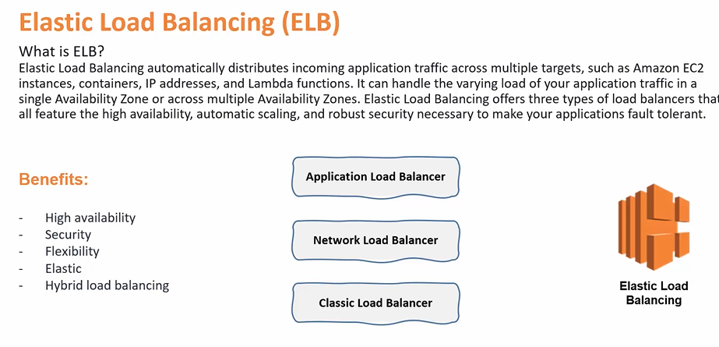

Slide 36





Elastic Load Balancing
Distributes incoming application or network traffic across multiple targets in a single Availability Zone or across multiple Availability Zones.
Scales your load balancer as traffic to your application changes over time.
Elastic Load
Balancing
IP addresses
Containers
Lambda functions
EC2 instances
Notes:
Modern high-traffic websites must serve hundreds of thousands—if not millions—of concurrent requests from users or clients, and then return the correct text, images, video, or application data in a fast and reliable manner. Additional servers are generally required to meet these high volumes.
Elastic Load Balancing is an AWS service that distributes incoming application or network traffic across multiple targets—such as Amazon Elastic Compute Cloud (Amazon EC2) instances, containers, internet protocol (IP) addresses, and Lambda functions—in a single Availability Zone or across multiple Availability Zones. Elastic Load Balancing scales your load balancer as traffic to your application changes over time. It can automatically scale to most workloads.

Slide 37
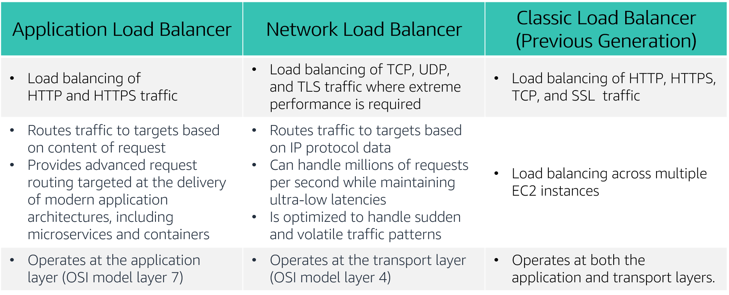
Types of load balancers
Notes:
Elastic Load Balancing is available in three types:
An Application Load Balancer operates at the application level (Open Systems Interconnection, or OSI, model layer 7). It routes traffic to targets—Amazon Elastic Compute Cloud (Amazon EC2) instances, containers, Internet Protocol (IP) addresses, and Lambda functions—based on the content of the request. It is ideal for advanced load balancing of Hypertext Transfer Protocol (HTTP) and Secure HTTP (HTTPS) traffic. An Application Load Balancer provides advanced request routing that is targeted at delivery of modern application architectures, including microservices and container-based applications. An Application Load Balancer simplifies and improves the security of your application by ensuring that the latest Secure Sockets Layer/Transport Layer Security (SSL/TLS) ciphers and protocols are used at all times.
A Network Load Balancer operates at the network transport level (OSI model layer 4), routing connections to targets—EC2 instances, microservices, and containers—based on IP protocol data. It works well for load balancing both Transmission Control Protocol (TCP) and User Datagram Protocol (UDP) traffic. A Network Load Balancer is capable of handling millions of requests per second while maintaining ultra-low latencies. A Network Load Balancer is optimized to handle sudden and volatile network traffic patterns.
A Classic Load Balancer provides basic load balancing across multiple EC2 instances, and it operates at both the application level and network transport level. A Classic Load Balancer supports the load balancing of applications that use HTTP, HTTPS, TCP, and SSL. The Classic Load Balancer is an older implementation. When possible, AWS recommends that you use a dedicated Application Load Balancer or Network Load Balancer.
To learn more about the differences between the three types of load balancers, see Product comparisons on the Elastic Load Balancing Features Page https://aws.amazon.com/elasticloadbalancing/features/?nc=sn&loc=2.

Slide 38

Scalability & High Availability
Scalability
means that an application / system can handle greater loads by adapting.
There are two kinds of scalability:
Vertical Scalability
Horizontal Scalability

Slide 39
Scalability & High Availability
Vertical Scalability
Vertical Scalability means increasing the size of the instance
For example, your application runs on a t2.micro, scaling that application vertically means running it on a t2.large
Scale Up & Down

Slide 40
Scalability & High Availability
Horizontal Scalability
Horizontal Scalability means increasing the number of instances for your application
This is very common for web applications / modern applications
Scale In (decrease), & Out (increase)

Slide 41
Scalability & High Availability
High Availability
means running your application in at least 2 Availability Zones
The goal of high availability is to survive a data center loss (disaster)

Slide 42
Scalability & High Availability
Vertical Scaling: Increase instance size (= scale up / down)
From: t2.nano - 0.5G of RAM, 1 vCPU
To: u-12tb1.metal – 12.3 TB of RAM, 448 vCPUs
Horizontal Scaling: Increase number of instances (= scale out / in)
Auto Scaling Group
Load Balancer
High Availability: Run instances for the same application across multi AZs
Auto Scaling Group multi AZs
Load Balancer multi AZs

Slide 43
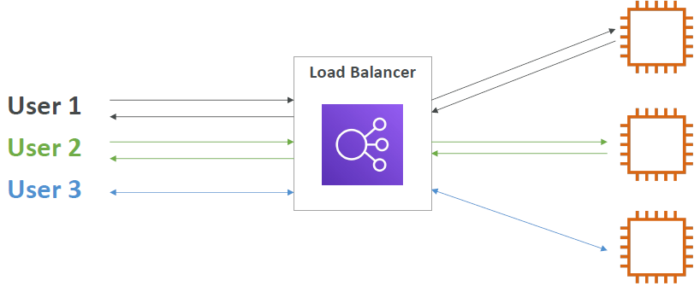
Load Balancing
Load balancers are servers that forward internet traffic to multiple servers (EC2 Instances) downstream.

Slide 44
Auto Scaling Group
The goal of an Auto Scaling Group (ASG) is to:
Scale out (add EC2 instances) to match an increased load
Scale in (remove EC2 instances) to match a decreased load
Ensure we have a minimum and a maximum number of machines running
Automatically register new instances to a load balancer
Replace unhealthy instances
Cost Savings: only run at an optimal capacity

Slide 45
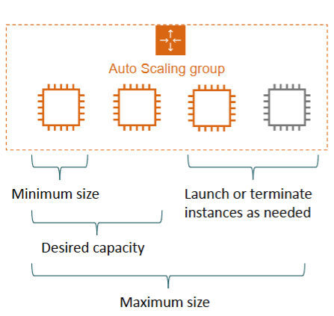
Auto Scaling Group

Slide 46
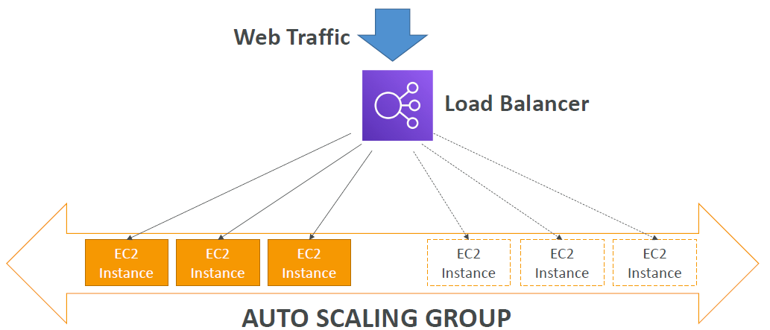
Auto Scaling Group

Slide 47


How Elastic Load Balancing works
With Application Load Balancers and Network Load Balancers, you register targets in target groups, and route traffic to the target groups.
With Classic Load Balancers, you register instances with the load balancer.
AWS Cloud
Load balancer accepts incoming traffic from clients.
Availability Zone A
Availability Zone B
Listener
Listener checks for connection requests.
Listener
Load balancer routes traffic only to healthy targets.
Load balancer performs health checks to monitor health of registered targets.
.
.
.
.
X
Target
Target
Target
Target
Target
Notes:
A load balancer accepts incoming traffic from clients and routes requests to its registered targets (such as EC2 instances) in one or more Availability Zones.
You configure your load balancer to accept incoming traffic by specifying one or more listeners. A listener is a process that checks for connection requests. It is configured with a protocol and port number for connections from clients to the load balancer. Similarly, it is configured with a protocol and port number for connections from the load balancer to the targets.
You can also configure your load balancer to perform health checks, which are used to monitor the health of the registered targets so that the load balancer only sends requests to the healthy instances. When the load balancer detects an unhealthy target, it stops routing traffic to that target. It then resumes routing traffic to that target when it detects that the target is healthy again.
There is a key difference in how the load balancer types are configured. With Application Load Balancers and Network Load Balancers, you register targets in target groups, and route traffic to the target groups. With Classic Load Balancers, you register instances with the load balancer.

Slide 48
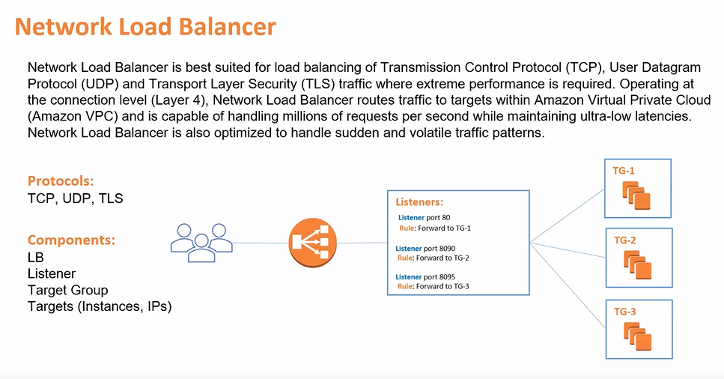

Slide 49
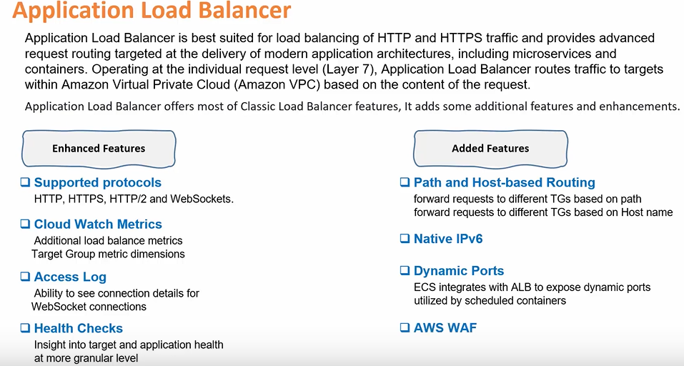

Slide 50
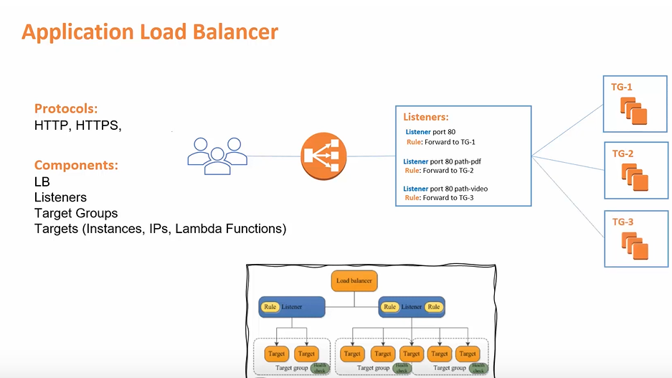

Slide 51



Elastic Load Balancing use cases
Highly available and fault-tolerant applications
Containerized applications
Elasticity and scalability
Virtual private cloud (VPC)
Hybrid environments
Invoke Lambda functions over HTTP(S)
Notes:
There are many reasons to use a load balancer:
Achieve high availability and better fault tolerance for your applications – Elastic Load Balancing balances traffic across healthy targets in multiple Availability Zones. If one or more of your targets in a single Availability Zone are unhealthy, Elastic Load Balancing will route traffic to healthy targets in other Availability Zones. After the targets return to a healthy state, load balancing will automatically resume traffic to them.
Automatically load balance your containerized applications – With enhanced container support for Elastic Load Balancing, you can now load balance across multiple ports on the same EC2 instance. You can also take advantage of deep integration with Amazon Elastic Container Service (Amazon ECS), which provides a fully-managed container offering. You only need to register a service with a load balancer, and Amazon ECS transparently manages the registration and de-registration of Docker containers. The load balancer automatically detects the port and dynamically reconfigures itself.
Automatically scale your applications – Elastic Load Balancing works with Amazon CloudWatch and Amazon EC2 Auto Scaling to help you scale your applications to the demands of your customers. Amazon CloudWatch alarms can trigger auto scaling for your EC2 instance fleet when the latency of any one of your EC2 instances exceeds a preconfigured threshold. Amazon EC2 Auto Scaling then provisions new instances and your applications will be ready to serve the next customer request. The load balancer will register the EC2 instance and direct traffic to it as needed.
Use Elastic Load Balancing in your virtual private cloud (VPC) – You can use Elastic Load Balancing to create a public entry point into your VPC, or to route request traffic between tiers of your application within your VPC. You can assign security groups to your load balancer to control which ports are open to a list of allowed sources. Because Elastic Load Balancing works with your VPC, all your existing network access control lists (network ACLs) and routing tables continue to provide additional network controls. When you create a load balancer in your VPC, you can specify whether the load balancer is public (default) or internal. If you select internal, you do not need to have an internet gateway to reach the load balancer, and the private IP addresses of the load balancer will be used in the load balancer’s Domain Name System (DNS) record.
Enable hybrid load balancing – Elastic Load Balancing enables you to load balance across AWS and on-premises resources by using the same load balancer. For example, if you must distribute application traffic across both AWS and on-premises resources, you can register all the resources to the same target group and associate the target group with a load balancer. Alternatively, you can use DNS-based weighted load balancing across AWS and on-premises resources by using two load balancers, with one load balancer for AWS and other load balancer for on-premises resources. You can also use hybrid load balancing to benefit separate applications where one application is in a VPC and the other application is in an on-premises location. Put the VPC targets in one target group and the on-premises targets in another target group, and then use content-based routing to route traffic to each target group.
Invoking Lambda functions over HTTP(S) – Elastic Load Balancing supports invoking Lambda functions to serve HTTP(S) requests. This enables users to access serverless applications from any HTTP client, including web browsers. You can register Lambda functions as targets and use the support for content-based routing rules in Application Load Balancers to route requests to different Lambda functions. You can use an Application Load Balancer as a common HTTP endpoint for applications that use servers and serverless computing. You can build an entire website by using Lambda functions, or combine EC2 instances, containers, on-premises servers, and Lambda functions to build applications.

Slide 52
Activity: Elastic Load Balancing
You must support traffic to a containerized application.
You have extremely spiky and unpredictable TCP traffic.
You need simple load balancing with multiple protocols.
You need to support a static or Elastic IP address, or an IP target outside a VPC.
You need a load balancer that can handle millions of requests per second while maintaining low latencies.
You must support HTTPS requests.
Notes:
For this activity, name the load balancer you would use for the given scenario.

Slide 53
Activity: Elastic Load Balancing Answers
You must support traffic to a containerized application.
Application Load Balancer
You have extremely spiky and unpredictable TCP traffic.
Network Load Balancer
You need simple load balancing with multiple protocols.
Classic Load Balancer
You need to support a static or Elastic IP address, or an IP target outside a VPC.
Network Load Balancer
You need a load balancer that can handle millions of requests per second while maintaining low latencies.
Network Load Balancer
You must support HTTPS requests.
Application Load Balancer
Notes:
The answers are revealed.

Slide 54

Load balancer monitoring
Amazon CloudWatch metrics – Used to verify that the system is performing as expected and creates an alarm to initiate an action if a metric goes outside an acceptable range.
Access logs – Capture detailed information about requests sent to your load balancer.
AWS CloudTrail logs – Capture the who, what, when, and where of API interactions in AWS services.
Notes:
You can use the following features to monitor your load balancers, analyze traffic patterns, and troubleshoot issues with your load balancers and targets:
Amazon CloudWatch metrics – Elastic Load Balancing publishes data points to Amazon CloudWatch for your load balancers and your targets. CloudWatch enables you to retrieve statistics about those data points as an ordered set of time series data, known as metrics. You can use metrics to verify that your system is performing as expected. For example, you can create a CloudWatch alarm to monitor a specified metric and initiate an action (such as sending a notification to an email address) if the metric goes outside what you consider an acceptable range.
Access logs – You can use access logs to capture detailed information about the requests that were made to your load balancer and store them as log files in Amazon Simple Storage Service (Amazon S3). You can use these access logs to analyze traffic patterns and to troubleshoot issues with your targets or backend applications.
AWS CloudTrail logs – You can use AWS CloudTrail to capture detailed information about the calls that were made to the Elastic Load Balancing application programming interface (API) and store them as log files in Amazon S3. You can use these CloudTrail logs to determine who made the call, what calls were made, when the call was made, the source IP address of where the call came from, and so on.

Slide 55
Monitoring AWS resources
To use AWS efficiently, you need insight into your AWS resources:
How do you know when you should launch more Amazon EC2 instances?
Is your application's performance or availability being affected by a lack of sufficient capacity?
How much of your infrastructure is actually being used?
Notes:
To use AWS efficiently, you need insight into your AWS resources.
For example, you might want to know:
When you should launch more Amazon EC2 instances?
If your application’s performance or availability is being affected by a lack of sufficient capacity?
How much of your infrastructure is actually being used?
How do you capture this information?

Slide 56



Amazon CloudWatch
Monitors –
AWS resources
Applications that run on AWS
Collects and tracks –
Standard metrics
Custom metrics
Alarms –
Send notifications to an Amazon SNS topic
Perform Amazon EC2 Auto Scaling or Amazon EC2 actions
Events –
Define rules to match changes in AWS environment and route these events to one or more target functions or streams for processing
Amazon
CloudWatch
Notes:
You can capture this information with Amazon CloudWatch.
Amazon CloudWatch is a monitoring and observability service that is built for DevOps engineers, developers, site reliability engineers (SRE), and IT managers. CloudWatch monitors your AWS resources (and the applications that you run on AWS) in real time. You can use CloudWatch to collect and track metrics, which are variables that you can measure for your resources and applications.
You can create an alarm to monitor any Amazon CloudWatch metric in your account and use the alarm to automatically send a notification to an Amazon Simple Notification Service (Amazon SNS) topic or perform an Amazon EC2 Auto Scaling or Amazon EC2 action. For example, you can create alarms on the CPU utilization of an EC2 instance, Elastic Load Balancing request latency, Amazon DynamoDB table throughput, Amazon Simple Queue Service (Amazon SQS) queue length, or even the charges on your AWS bill. You can also create an alarm on custom metrics that are specific to your custom applications or infrastructure.
You can also use Amazon CloudWatch Events to define rules that match incoming events (or changes in your AWS environment) and route them to targets for processing. Targets can include Amazon EC2 instances, AWS Lambda functions, Kinesis streams, Amazon ECS tasks, Step Functions state machines, Amazon SNS topics, Amazon SQS queues, and built-in targets. CloudWatch Events becomes aware of operational changes as they occur. CloudWatch Events responds to these operational changes and takes corrective action as necessary, by sending messages to respond to the environment, activating functions, making changes, and capturing state information.
With CloudWatch, you gain system-wide visibility into resource utilization, application performance, and operational health. There is no upfront commitment or minimum fee; you simply pay for what you use. You are charged at the end of the month for what you use.

Slide 57
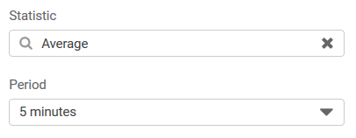
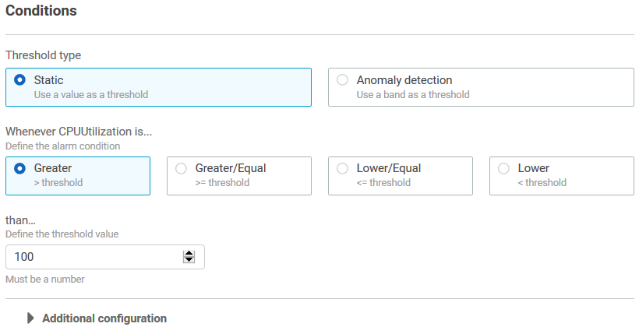
CloudWatch alarms
Create alarms based on –
Static threshold
Anomaly detection
Metric math expression
Specify –
Namespace
Metric
Statistic
Period
Conditions
Additional configuration
Actions
Notes:
You can create a CloudWatch alarm that watches a single CloudWatch metric or the result of a math expression based on CloudWatch metrics. You can create a CloudWatch alarm based on a static threshold, anomaly detection, or a metric math expression.
When you create an alarm based on a static threshold, you choose a CloudWatch metric for the alarm to watch and the threshold for that metric. The alarm goes to ALARM state when the metric breaches the threshold for a specified number of evaluation periods.
For an alarm based on a static threshold, you must specify the:
Namespace – A namespace contains the CloudWatch metric that you want, for example, AWS/EC2.
Metric – A metric is the variable you want to measure, for example, CPU Utilization.
Statistic – A statistic can be an average, sum, minimum, maximum, sample count, a predefined percentile, or a custom percentile.
Period – A period is the evaluation period for the alarm. When the alarm is evaluated, each period is aggregated into one data point.
Conditions – When you specify the conditions for a static threshold, you specify whenever the metric is Greater, Greater or Equal, Lower or Equal, or Lower than the threshold value, and you also specify the threshold value.
Additional configuration information – This includes the number of data points within the evaluation period that must be breached to trigger the alarm, and how CloudWatch should treat missing data when it evaluates the alarm.
Actions – You can choose to send a notification to an Amazon SNS topic, or to perform an Amazon EC2 Auto Scaling action or Amazon EC2 action.
For more information on creating CloudWatch alarms, see the topics under Using Alarms in the AWS Documentation at https://docs.aws.amazon.com/AmazonCloudWatch/latest/monitoring/AlarmThatSendsEmail.html.

Slide 58




Activity: Amazon CloudWatch
If average CPU utilization is > 60% for 5 minutes…
Amazon EC2
If the number of simultaneous connections is > 10 for 1 minute…
Amazon RDS
If the maximum bucket size in bytes is around 3 for 1 day…
Amazon S3
If the number of healthy hosts is < 5 for 10 minutes…
Elastic Load Balancing
If the volume of read operations is > 1,000 for 10 seconds…
Amazon Elastic Block Store
Notes:
For this activity, see if you can identify which are correct CloudWatch alarms. For the ones that are incorrect, see if you can identify the error.

Slide 59
Activity: Amazon CloudWatch Answers
If average CPU utilization is > 60% for 5 minutes…
Correct!
Amazon EC2
If the number of simultaneous connections is > 10 for 1 minute…
Correct!
Amazon RDS
If the maximum bucket size in bytes is around 3 for 1 day…
Incorrect. Around is not a threshold option. You must specify a threshold of >, >=, <=, or <.
Amazon S3
If the number of healthy hosts is < 5 for 10 minutes…
Correct!
Elastic Load Balancing
If the volume of read operations is > 1,000 for 10 seconds…
Incorrect. You must specify a statistic (for example, average volume).
Amazon Elastic Block Store
Notes:
The answers are revealed.

Slide 60
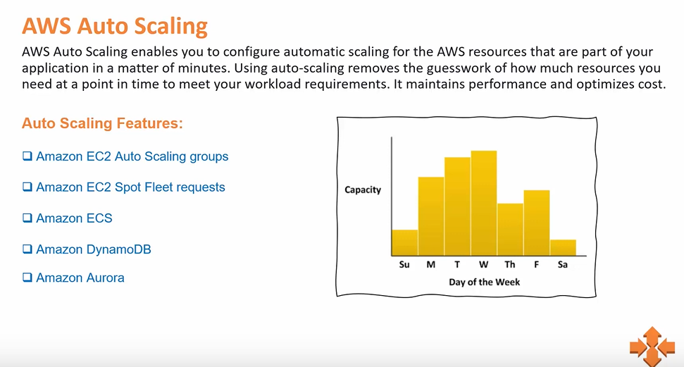

Slide 61
Why is scaling important?
Unused
capacity
Over
capacity
Su M T W Th F Sa
Su M T W Th F Sa
Used capacity (demand)
Provisioned capacity
Notes:
Scaling is the ability to increase or decrease the compute capacity of your application. To understand why scaling is important, consider this example of a workload that has varying resource requirements. In this example, the most resource capacity is required on Wednesday, and the least resource capacity is required on Sunday.
One option is to allocate more than enough capacity so you can always meet your highest demand—in this case, Wednesday. However, this situation means that you are running resources that will be underutilized most days of the week. With this option, your costs are not optimized.
Another option is to allocate less capacity to reduce costs. This situation means that you are under capacity on certain days. If you don't solve your capacity problem, your application could underperform or potentially even become unavailable for users.

Slide 62
Amazon EC2 Auto Scaling
Helps you maintain application availability
Enables you to automatically add or remove EC2 instances according to conditions that you define
Detects impaired EC2 instances and unhealthy applications, and replaces the instances without your intervention
Provides several scaling options – Manual, scheduled, dynamic or on-demand, and predictive
Su M T W Th F Sa
Used capacity (demand)
Provisioned capacity
Notes:
In the cloud, because computing power is a programmatic resource, you can take a flexible approach to scaling. Amazon EC2 Auto Scaling is an AWS service that helps you maintain application availability and enables you to automatically add or remove EC2 instances according to conditions you define. You can use the fleet management features of EC2 Auto Scaling to maintain the health and availability of your fleet.
Amazon EC2 Auto Scaling provides several ways to adjust scaling to best meet the needs of your applications. You can add or remove EC2 instances manually, on a schedule, in response to changing demand, or in combination with AWS Auto Scaling for predictive scaling. Dynamic scaling and predictive scaling can be used together to scale faster.
To learn more about Amazon EC2 Auto Scaling, see the Amazon EC2 Auto Scaling product page at https://aws.amazon.com/ec2/autoscaling .

Slide 63

Typical weekly traffic at Amazon.com
Provisioned capacity
Sunday
Monday
Tuesday
Wednesday
Thursday
Friday
Saturday
Notes:
Automatic scaling is useful for predictable workloads—for example, the weekly traffic at the retail company Amazon.com.

Slide 64


November traffic to Amazon.com
76 percent
Provisioned capacity
The challenge is to efficiently guess the unknown quantity of how much compute capacity you need.
24 percent
November
Notes:
Automatic scaling is also useful for dynamic on-demand scaling. Amazon.com experiences a seasonal peak in traffic in November (on Black Friday and Cyber Monday, which are days at the end of November when US retailers hold major sales). If Amazon provisions a fixed capacity to accommodate the highest use, 76 percent of the resources are idle for most of the year. Capacity scaling is necessary to support the fluctuating demands for service. Without scaling, the servers could crash due to saturation, and the business would lose customer confidence.

Slide 65


Auto Scaling groups
Auto Scaling group
An Auto Scaling group is a collection of EC2 instances that are treated as a logical grouping for the purposes of automatic scaling and management.
Minimum size
Launch or terminate instances as needed
Desired capacity
Maximum size
Notes:
An Auto Scaling group is a collection of Amazon EC2 instances that are treated as a logical grouping for the purposes of automatic scaling and management. The size of an Auto Scaling group depends on the number of instances you set as the desired capacity. You can adjust its size to meet demand, either manually or by using automatic scaling. See more about Auto Scaling Groups at https://docs.aws.amazon.com/autoscaling/ec2/userguide/auto-scaling-groups.html.
You can specify the minimum number of instances in each Auto Scaling group, and Amazon EC2 Auto Scaling is designed to prevent your group from going below this size. You can specify the maximum number of instances in each Auto Scaling group, and Amazon EC2 Auto Scaling is designed to prevent your group from going above this size. If you specify the desired capacity, either when you create the group or at any time afterwards, Amazon EC2 Auto Scaling is designed to adjust the size of your group so it has the specified number of instances. If you specify scaling policies, then Amazon EC2 Auto Scaling can launch or terminate instances as demand on your application increases or decreases.
For example, this Auto Scaling group has a minimum size of one instance, a desired capacity of two instances, and a maximum size of four instances. The scaling policies that you define adjust the number of instances within your minimum and maximum number of instances, based on the criteria that you specify.

Slide 66
Scaling out versus scaling in
Elastic Load Balancing
Auto Scaling group
Auto Scaling group
Auto Scaling group
Base configuration
Scale out (launch instances)
Scale in (terminate instances)
Notes:
With Amazon EC2 Auto Scaling, launching instances is referred to as scaling out, and terminating instances is referred to as scaling in.

Slide 67


How Amazon EC2 Auto Scaling works
What
Where
When
VPC
Maintain current number
Private subnet
Health checks
AMI
Auto Scaling group
Manual scaling
EC2 instance
Min, max, desired capacity
Scheduled scaling
Launch configuration
Auto Scaling group
Scheduled actions
AMI
Instance type
IAM role
Security groups
EBS volumes
VPC and subnets
Load balancer
Dynamic scaling
Scaling policies
Predictive scaling
AWS Auto Scaling
Notes:
To launch EC2 instances, an Auto Scaling group uses a launch configuration, which is an instance configuration template. You can think of a launch configuration as what you are scaling. When you create a launch configuration, you specify information for the instances. The information you specify includes the ID of the Amazon Machine Image (AMI), the instance type, AWS Identity and Access Management (IAM) role, additional storage, one or more security groups, and any Amazon Elastic Block Store (Amazon EBS) volumes. See more information on the launch configuration at https://docs.aws.amazon.com/autoscaling/ec2/userguide/launch-configurations.html.
You define the minimum and maximum number of instances and desired capacity of your Auto Scaling group. Then, you launch it into a subnet within a VPC (you can think of this as where you are scaling). Amazon EC2 Auto Scaling integrates with Elastic Load Balancing to enable you to attach one or more load balancers to an existing Auto Scaling group. After you attach the load balancer, it automatically registers the instances in the group and distributes incoming traffic across the instances.
Finally, you specify when you want the scaling event to occur. You have many scaling options:
Maintain current instance levels at all times – You can configure your Auto Scaling group to maintain a specified number of running instances at all times. To maintain the current instance levels, Amazon EC2 Auto Scaling performs a periodic health check on running instances in an Auto Scaling group. When Amazon EC2 Auto Scaling finds an unhealthy instance, it terminates that instance and launches a new one.
Manual scaling – With manual scaling, you specify only the change in the maximum, minimum, or desired capacity of your Auto Scaling group. See more on manual scaling at https://docs.aws.amazon.com/autoscaling/ec2/userguide/as-manual-scaling.html.
Scheduled scaling– With scheduled scaling, scaling actions are performed automatically as a function of date and time. This is useful for predictable workloads when you know exactly when to increase or decrease the number of instances in your group. For example, say that every week, the traffic to your web application starts to increase on Wednesday, remains high on Thursday, and starts to decrease on Friday. See more on scheduled scaling at https://docs.aws.amazon.com/autoscaling/ec2/userguide/ec2-auto-scaling-scheduled-scaling.html. You can plan your scaling actions based on the predictable traffic patterns of your web application. To implement scheduled scaling, you create a scheduled action.
– A more advanced way to scale your resources enables you to define parameters that control the scaling process. For example, you have a web application that currently runs on two instances and you want the CPU utilization of the Auto Scaling group to stay close to 50 percent when the load on the application changes. This option is useful for scaling in response to changing conditions, when you don't know when those conditions will change. Dynamic scaling gives you extra capacity to handle traffic spikes without maintaining an excessive amount of idle resources. You can configure your Auto Scaling group to scale automatically to meet this need. More on dynamic scaling at https://docs.aws.amazon.com/autoscaling/ec2/userguide/as-scale-based-on-demand.html. The scaling policy type determines how the scaling action is performed. You can use Amazon EC2 Auto Scaling with Amazon CloudWatch to trigger the scaling policy in response to an alarm. See policy types at https://docs.aws.amazon.com/autoscaling/ec2/userguide/as-scale-based-on-demand.html#as-scaling-types.
Predictive scaling – You can use Amazon EC2 Auto Scaling with AWS Auto Scaling to implement predictive scaling, where your capacity scales based on predicted demand. Predictive scaling uses data that is collected from your actual EC2 usage, and the data is further informed by billions of data points that are drawn from our own observations. AWS then uses well-trained machine learning models to predict your expected traffic (and EC2 usage), including daily and weekly patterns. The model needs at least 1 day of historical data to start making predictions. It is re-evaluated every 24 hours to create a forecast for the next 48 hours. The prediction process produces a scaling plan that can drive one or more groups of automatically scaled EC2 instances. See more on predictive scaling at https://aws.amazon.com/blogs/aws/new-predictive-scaling-for-ec2-powered-by-machine-learning/.
To learn more about these options, see Scaling the Size of Your Auto Scaling Group in the AWS Documentation at https://docs.aws.amazon.com/autoscaling/ec2/userguide/scale-your-group.html.

Slide 68



Implementing dynamic scaling
Elastic Load Balancing
Auto Scaling group
CPU utilization
If average CPU utilization is > 60% for 5 minutes…
Run Amazon EC2 Auto Scaling policy
Amazon EC2 Auto Scaling
Amazon CloudWatch
Notes:
One common configuration for implementing dynamic scaling is to create a CloudWatch alarm that is based on performance information from your EC2 instances or load balancer. When a performance threshold is breached, a CloudWatch alarm triggers an automatic scaling event that either scales out or scales in EC2 instances in the Auto Scaling group.
To understand how it works, consider this example:
You create an Amazon CloudWatch alarm to monitor CPU utilization across your fleet of EC2 instances and run automatic scaling policies if the average CPU utilization across the fleet goes above 60 percent for 5 minutes.
Amazon EC2 Auto Scaling instantiates a new EC2 instance into your Auto Scaling group based on the launch configuration that you create.
After the new instance is added, Amazon EC2 Auto Scaling makes a call to Elastic Load Balancing to register the new EC2 instance in that Auto Scaling group.
Elastic Load Balancing then performs the required health checks and starts distributing traffic to that instance. Elastic Load Balancing routes traffic between EC2 instances and feeds metrics to Amazon CloudWatch.
Amazon CloudWatch, Amazon EC2 Auto Scaling, and Elastic Load Balancing work well individually. Together, however, they become more powerful and increase the control and flexibility over how your application handles customer demand.

Slide 69

AWS Auto Scaling
Monitors your applications and automatically adjusts capacity to maintain steady, predictable performance at the lowest possible cost
Provides a simple, powerful user interface that enables you to build scaling plans for resources, including –
Amazon EC2 instances and Spot Fleets
Amazon Elastic Container Service (Amazon ECS) Tasks
Amazon DynamoDB tables and indexes
Amazon Aurora Replicas
AWS Auto Scaling
Notes:
So far, you learned about scaling EC2 instances with Amazon EC2 Auto Scaling. You also learned that you can use Amazon EC2 Auto Scaling with AWS Auto Scaling to perform predictive scaling.
AWS Auto Scaling is a separate service that monitors your applications. It automatically adjusts capacity to maintain steady, predictable performance at the lowest possible cost. The service provides a simple, powerful user interface that enables you to build scaling plans for resources, including:
Amazon EC2 instances and Spot Fleets
Amazon Elastic Container Service (Amazon ECS) tasks
Amazon DynamoDB tables and indexes
Amazon Aurora Replicas
If you are already using Amazon EC2 Auto Scaling to dynamically scale your EC2 instances, you can now use it with AWS Auto Scaling to scale additional resources for other AWS services.
To learn more information about AWS Auto Scaling, see AWS Auto Scaling at https://aws.amazon.com/autoscaling/.

Slide 70

Lab 6: Scale and Load Balance Your Architecture
Notes:
You will now complete Lab 6: Scale and Load Balance Your Architecture.

Slide 71





Lab 6: Scenario
AWS Cloud
Region
Availability Zone A
Availability Zone B
VPC: 10.0.0.0/16
Internet gateway
Public subnet 2: 10.0.2.0/24
Public subnet 1: 10.0.0.0/24
Security group
NAT gateway
Web Server 1
Private subnet 1: 10.0.1.0/24
Private subnet 2: 10.0.3.0/24
Security group
Security group
RDS DB Primary
RDS DB Secondary
Notes:
In this lab, you will use Elastic Load Balancing and Amazon EC2 Auto Scaling to load balance and scale your infrastructure. You will start with the given infrastructure.

Slide 72
Lab 6: Tasks
Create an Amazon Machine Image (AMI) from a running instance.
Create an Application Load Balancer.
Create a launch configuration and an Auto Scaling group.
Automatically scale new instances within a private subnet.
Create Amazon CloudWatch alarms and monitor performance of your infrastructure.
Notes:
In this lab, you will complete the following tasks:
Create an Amazon Machine Image (AMI) from a running instance.
Create an Application Load Balancer.
Create a launch configuration and an Auto Scaling group.
Automatically scale new instances within a private subnet.
Create Amazon CloudWatch alarms and monitor performance of your infrastructure.

Slide 73

Lab 6: Final product
AWS Cloud
Region
Availability Zone A
Availability Zone B
VPC: 10.0.0.0/16
Internet gateway
Public subnet 1: 10.0.0.0/24
Public subnet 2: 10.0.2.0/24
Security group
NAT gateway
Application Load Balancer
Private subnet 1: 10.0.1.0/24
Private subnet 2: 10.0.3.0/24
Auto Scaling group
Security group
Security group
Web Instance
Web Instance
Security group
Security group
RDS DB Primary
RDS DB Secondary
Notes:
The diagram summarizes what you will have built after you complete the lab.

Slide 74
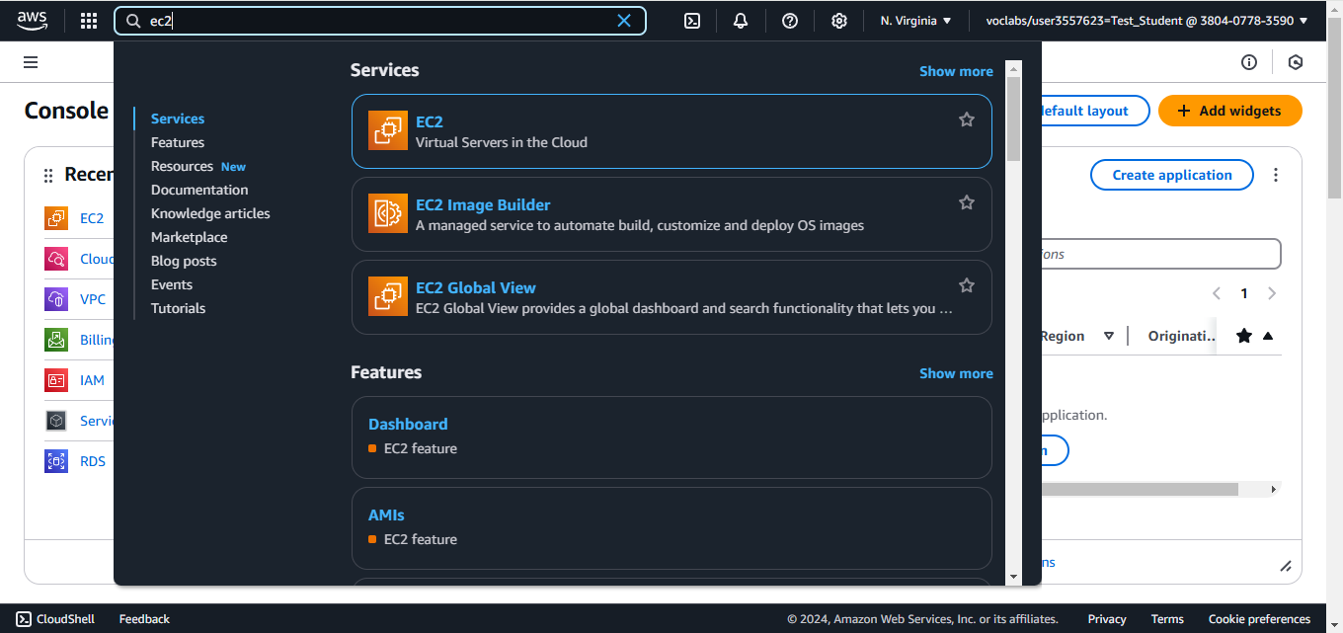
Search for EC2

Slide 75
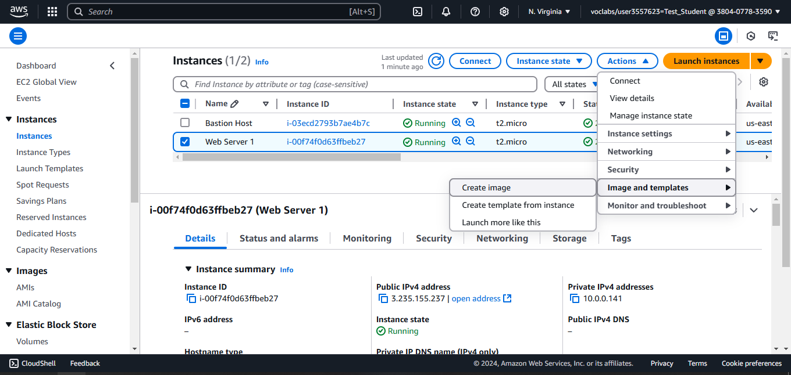
Create an image from Web Server instance

Slide 76
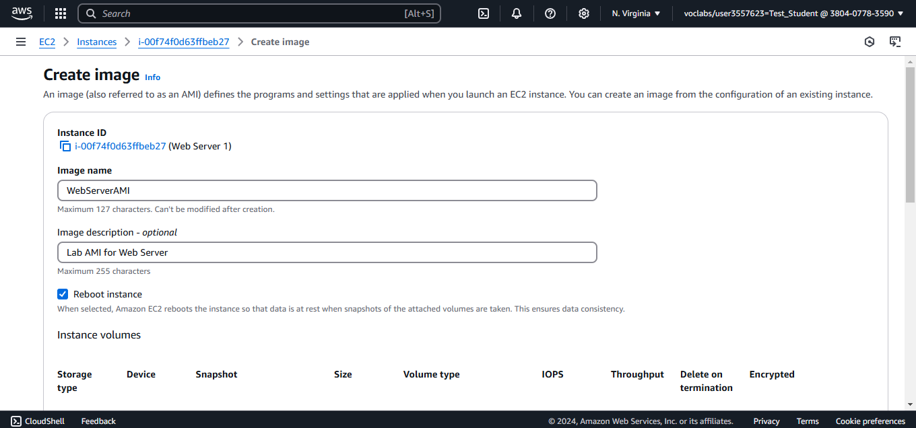
Configure image name and description

Slide 77
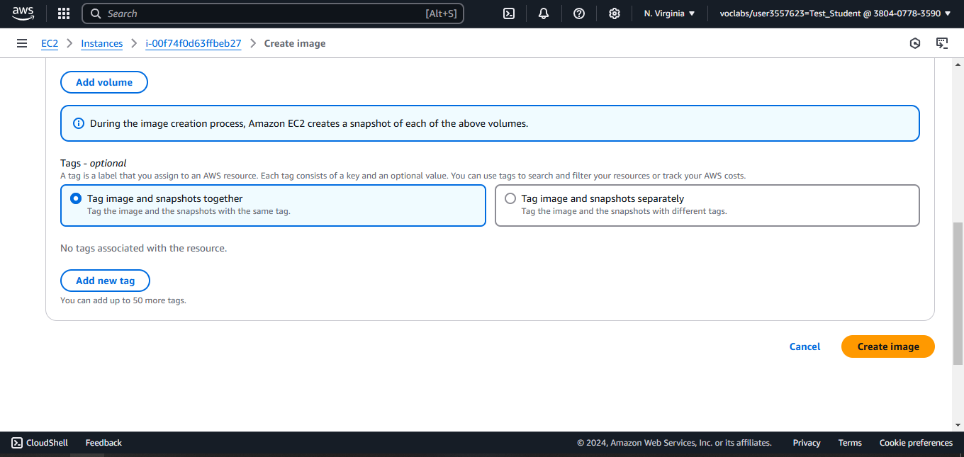
Create the image

Slide 78
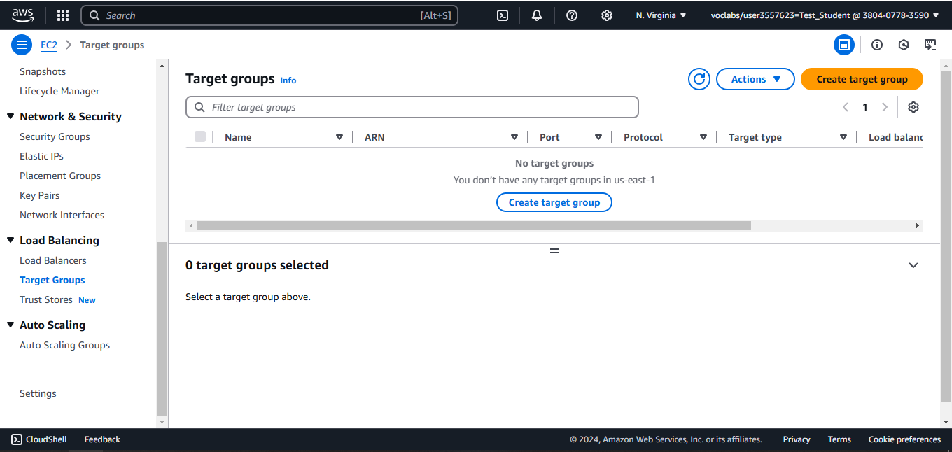
Create a target group for the load balancer

Slide 79
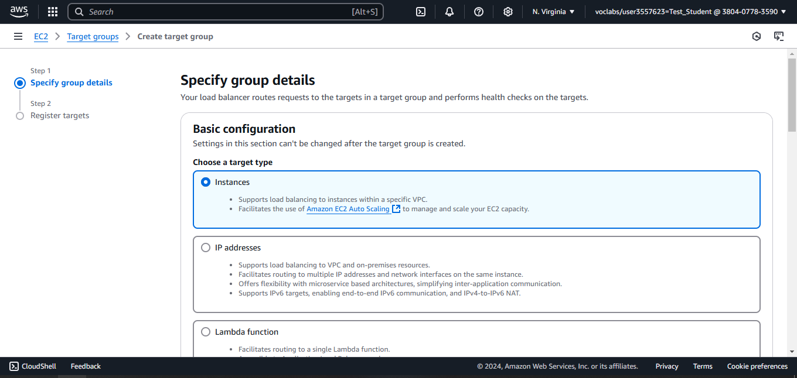
Choose a target type

Slide 80
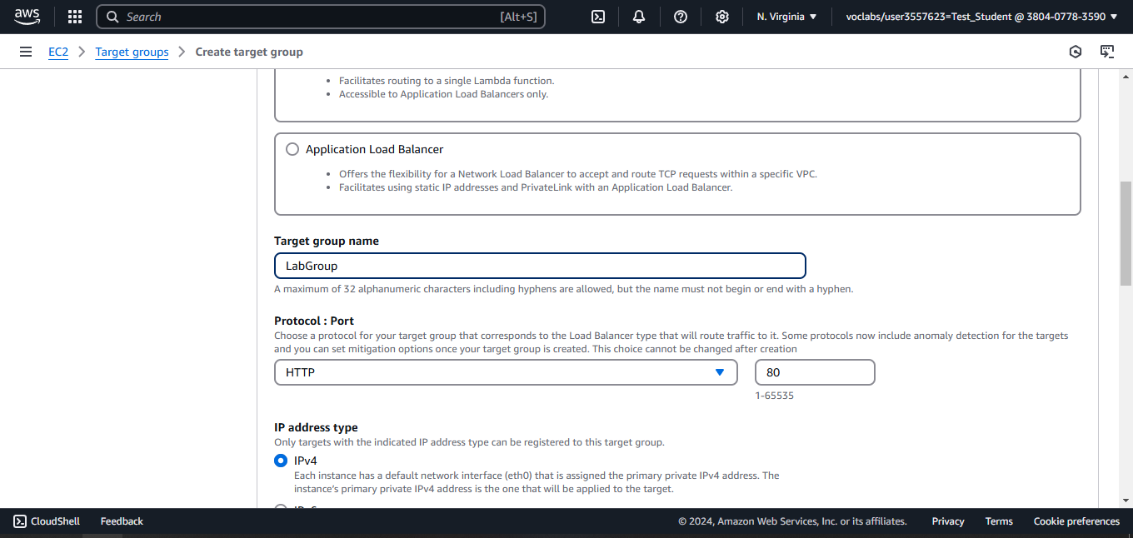
Configure the name of the target group

Slide 81
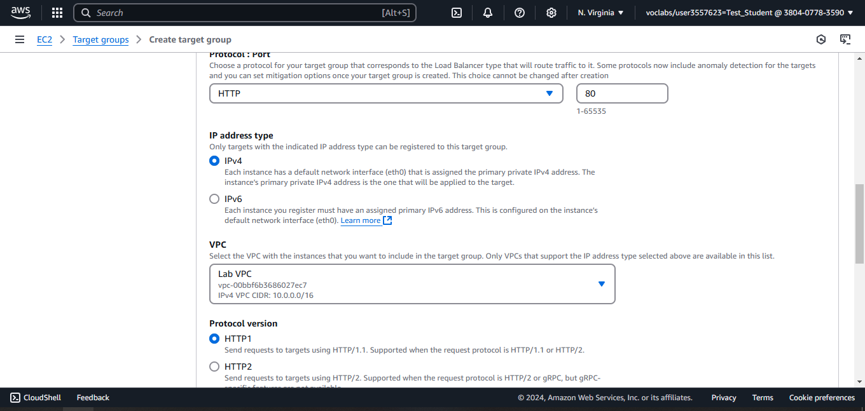
Select the VPC

Slide 82
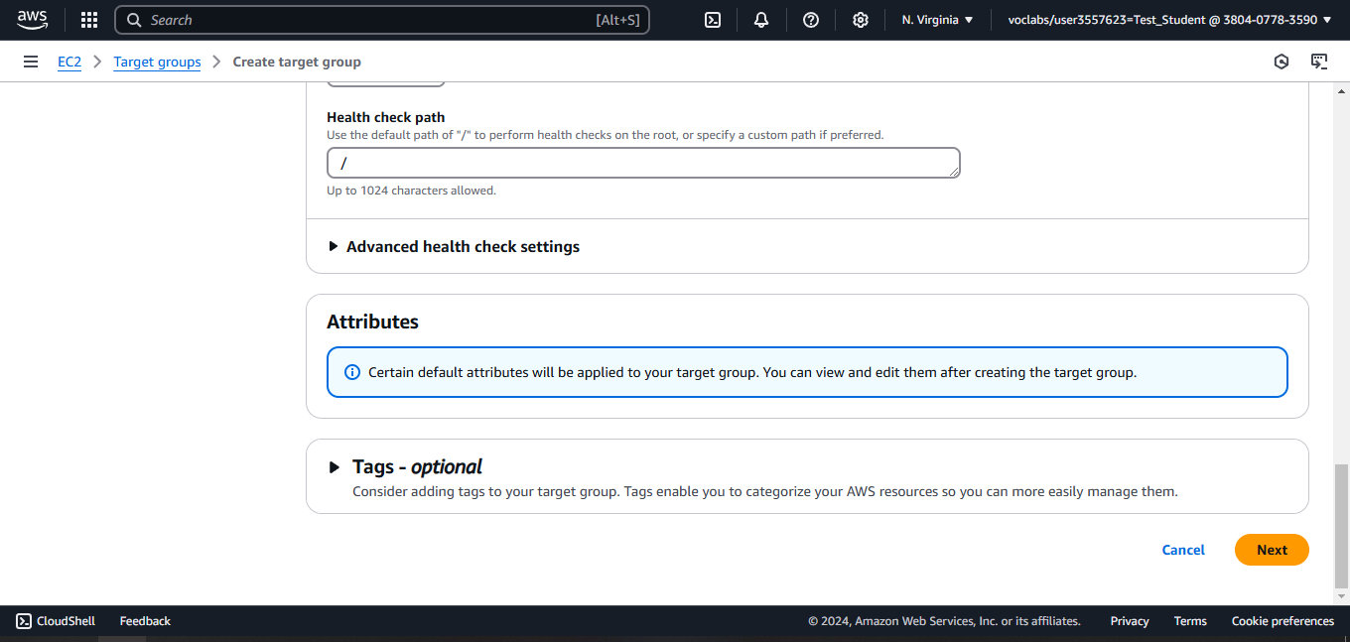

Slide 83
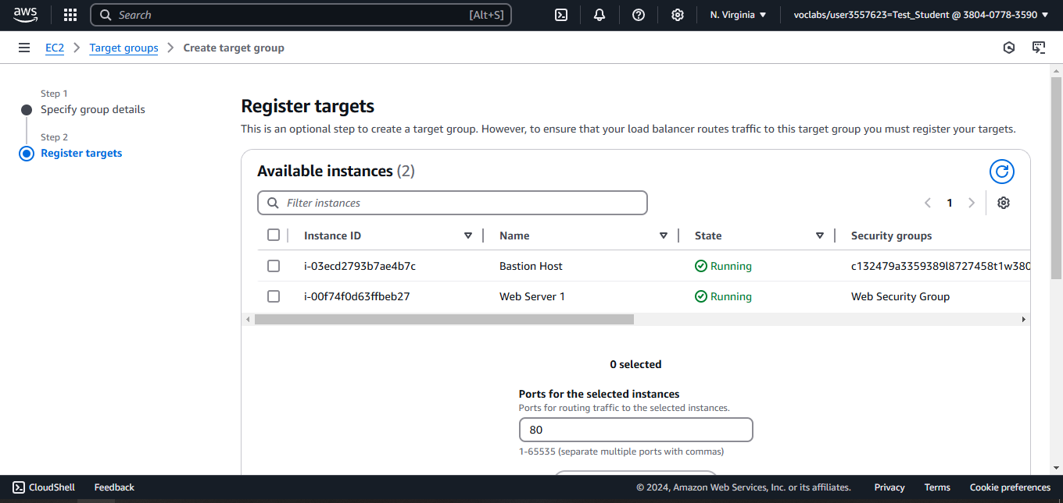
Leave the target instances

Slide 84
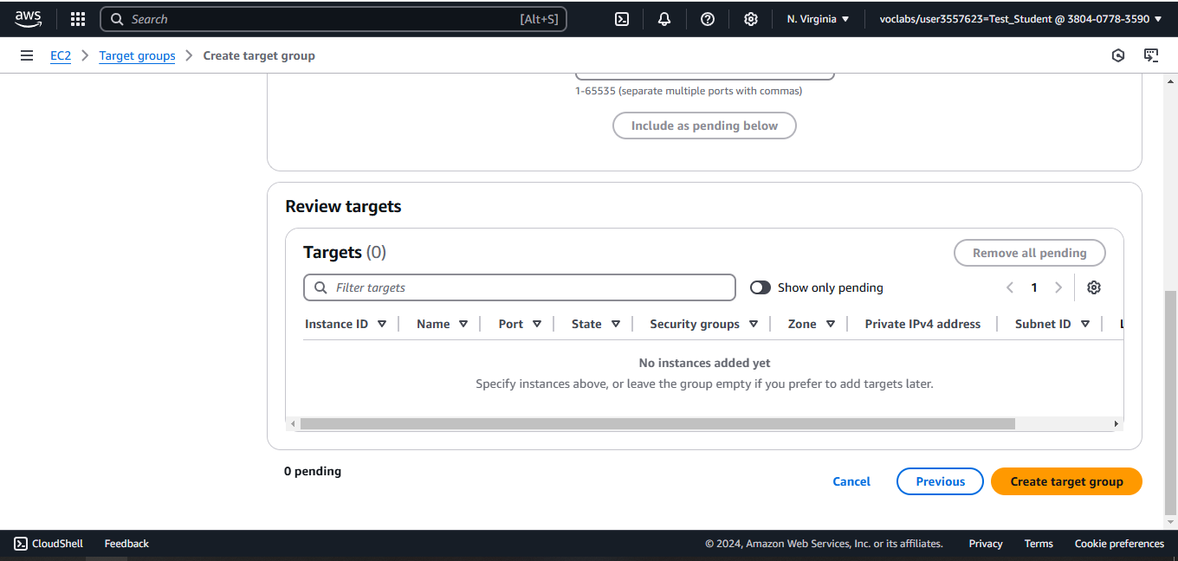
Create the target group

Slide 85
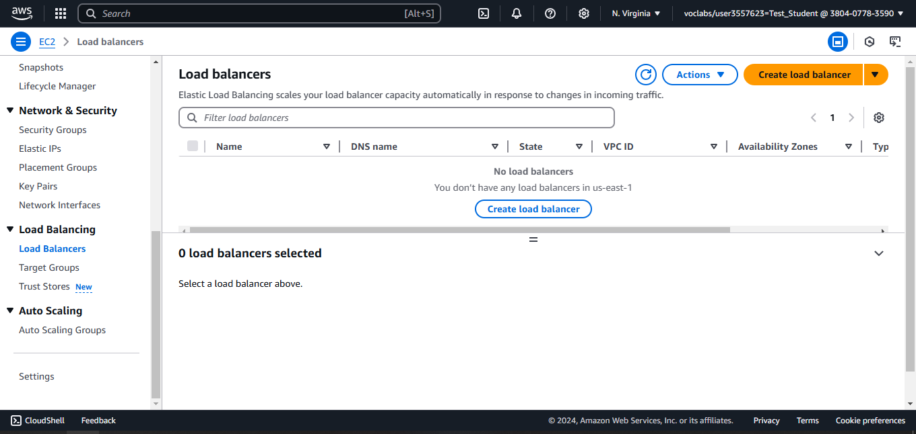
Create a load balancer

Slide 86
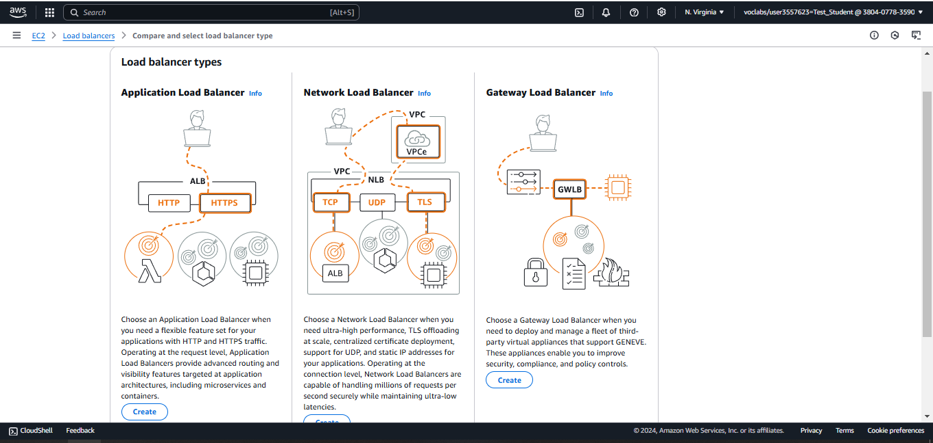
Create an Application Load Balancer

Slide 87
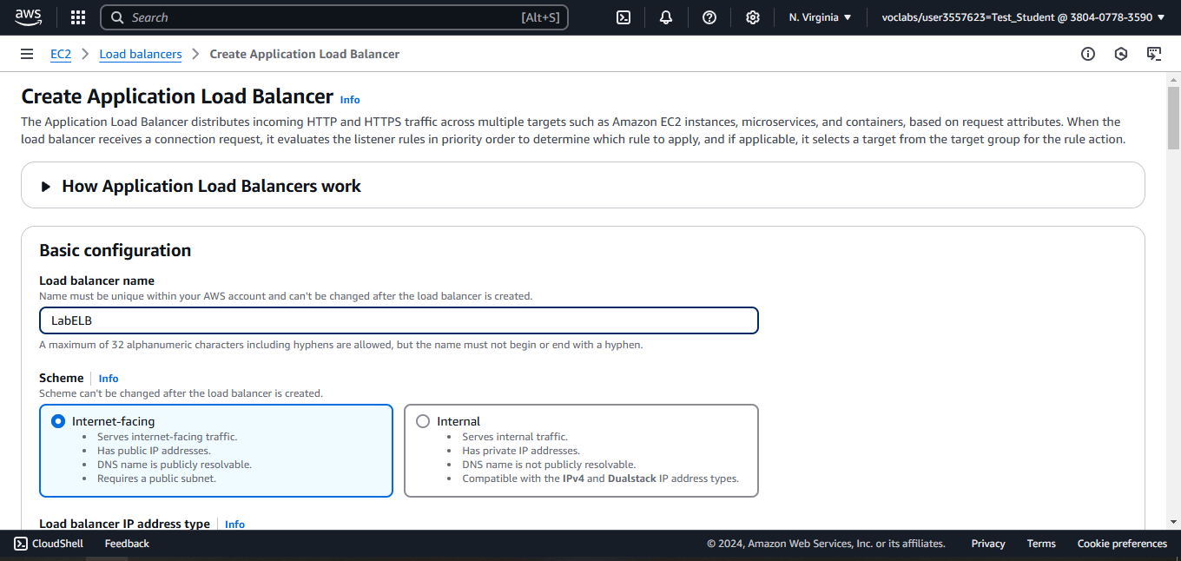
Configure the load balancer name

Slide 88
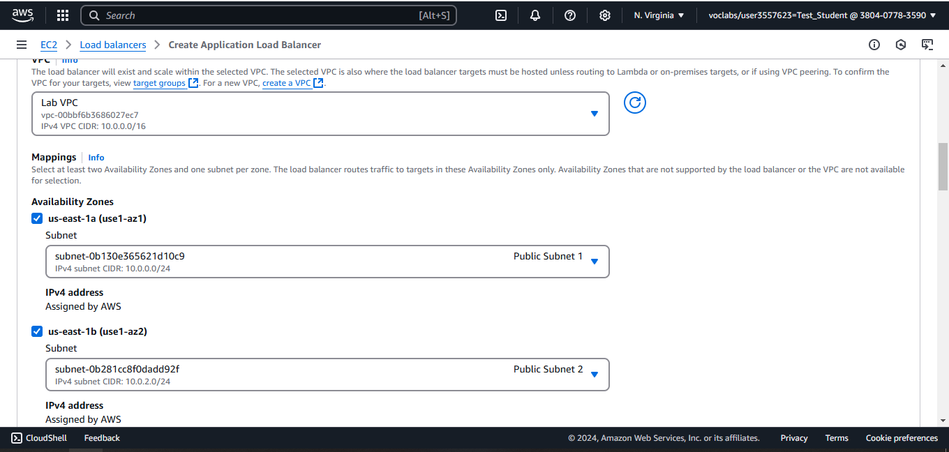
Select the AZs and the subnets

Slide 89
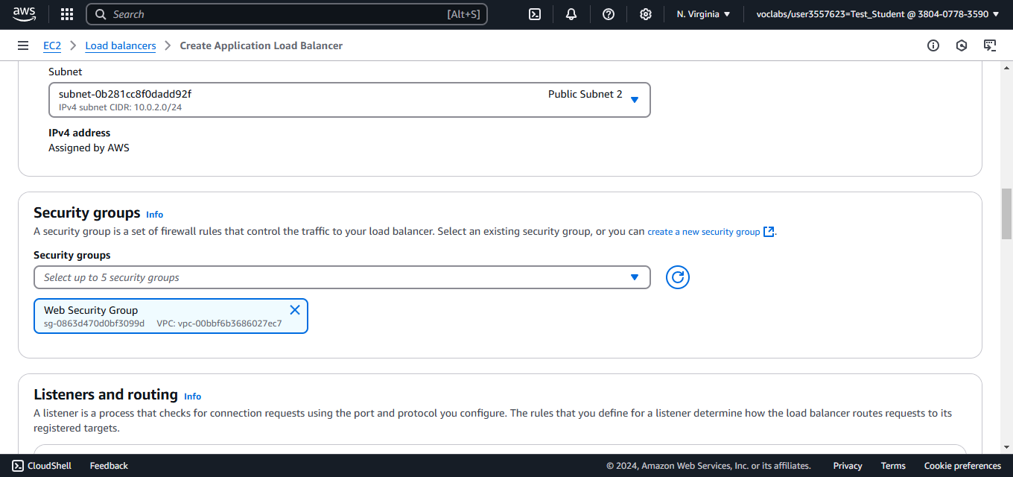
Select the Security Group

Slide 90
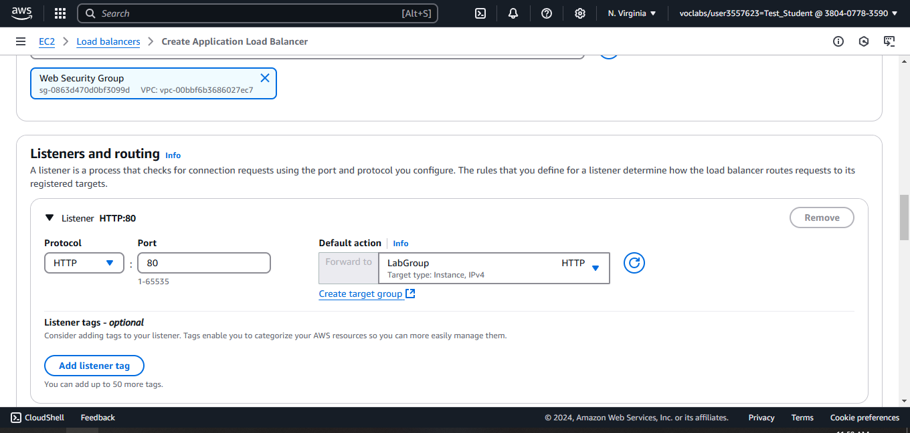
Select the target group

Slide 91
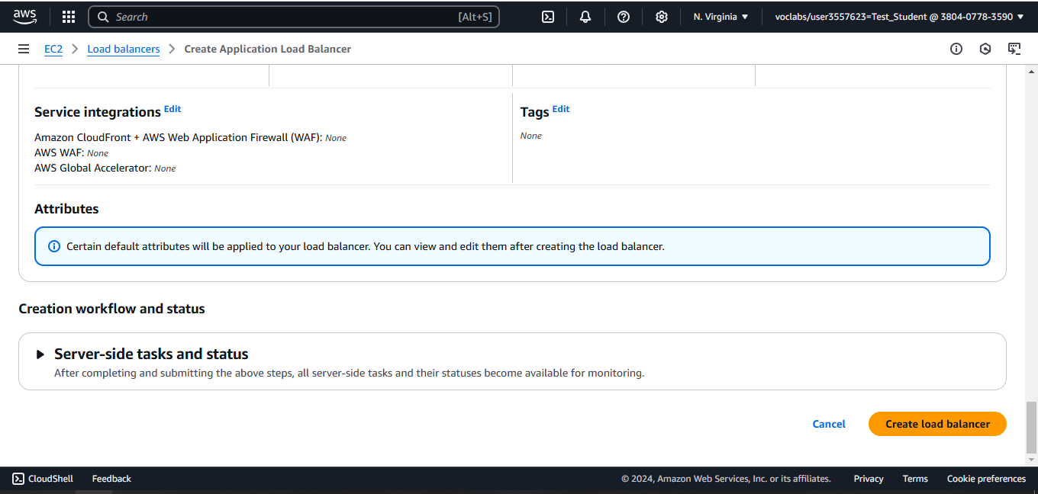
Create the Load Balancer

Slide 92
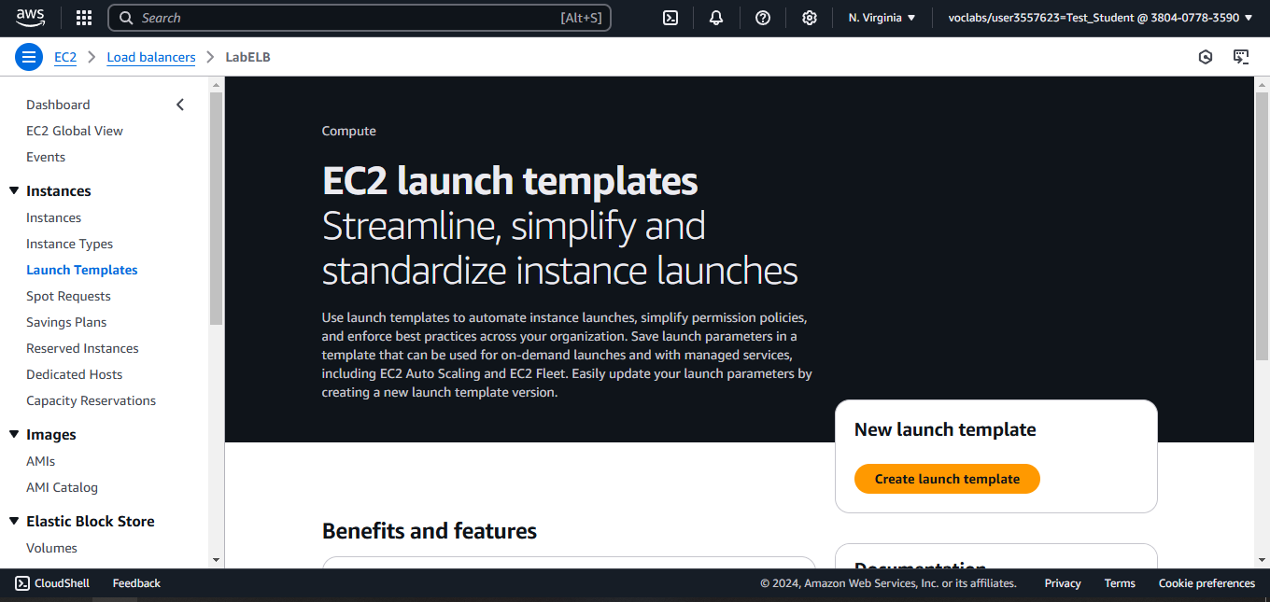
Create a launch template for the auto scaling group

Slide 93
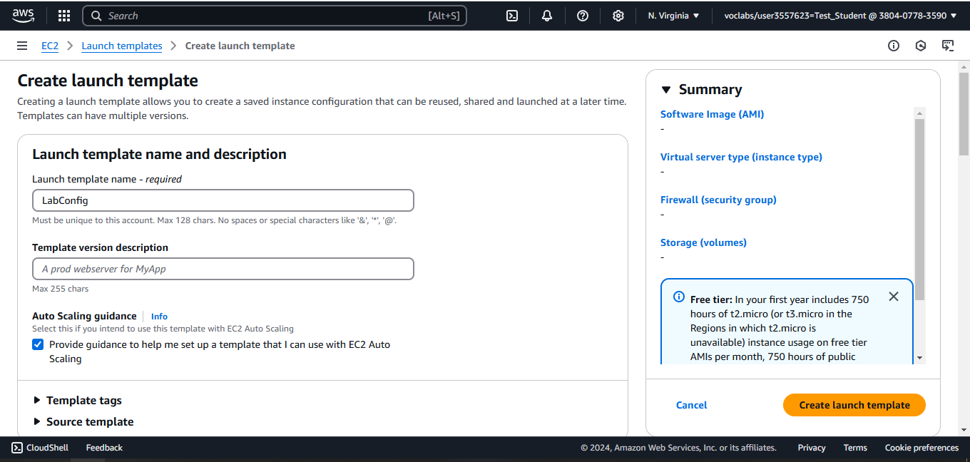
Configure the template name

Slide 94
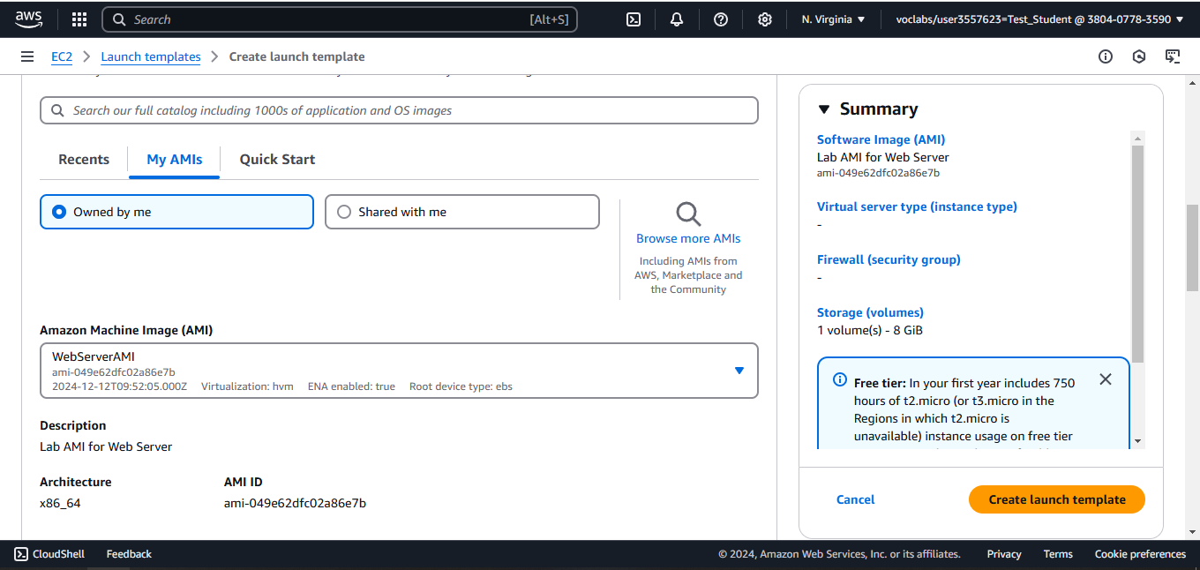
Select the AMI (the created image from Web Server)

Slide 95
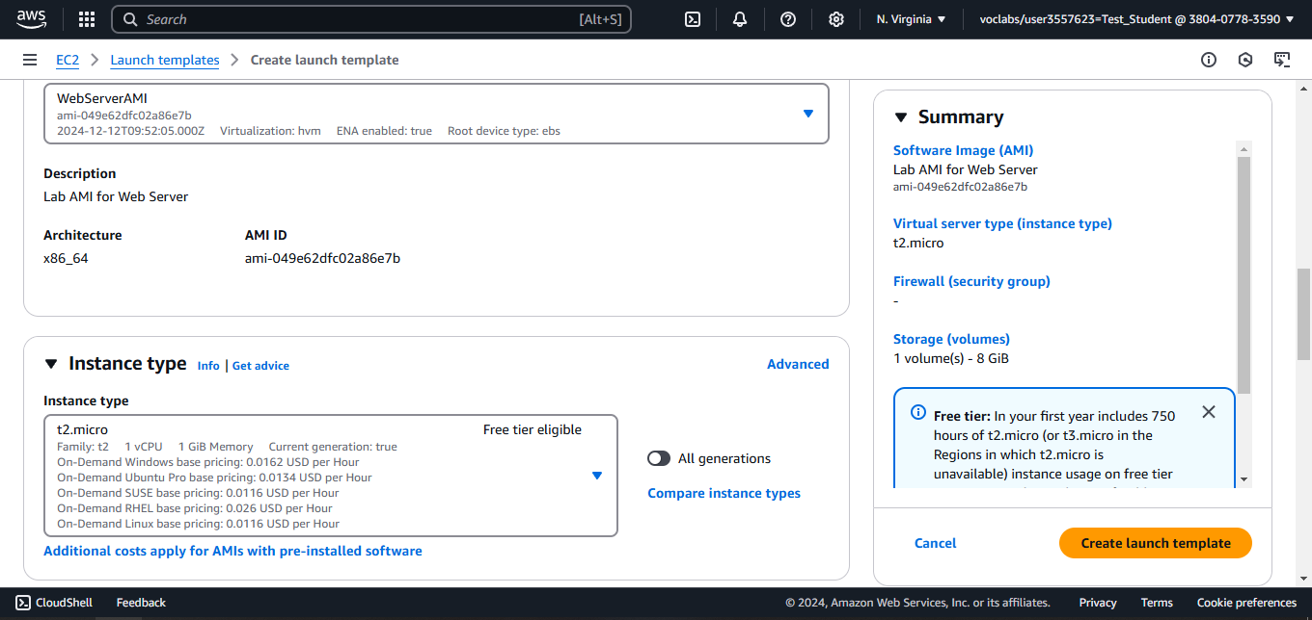
Select the instance type

Slide 96
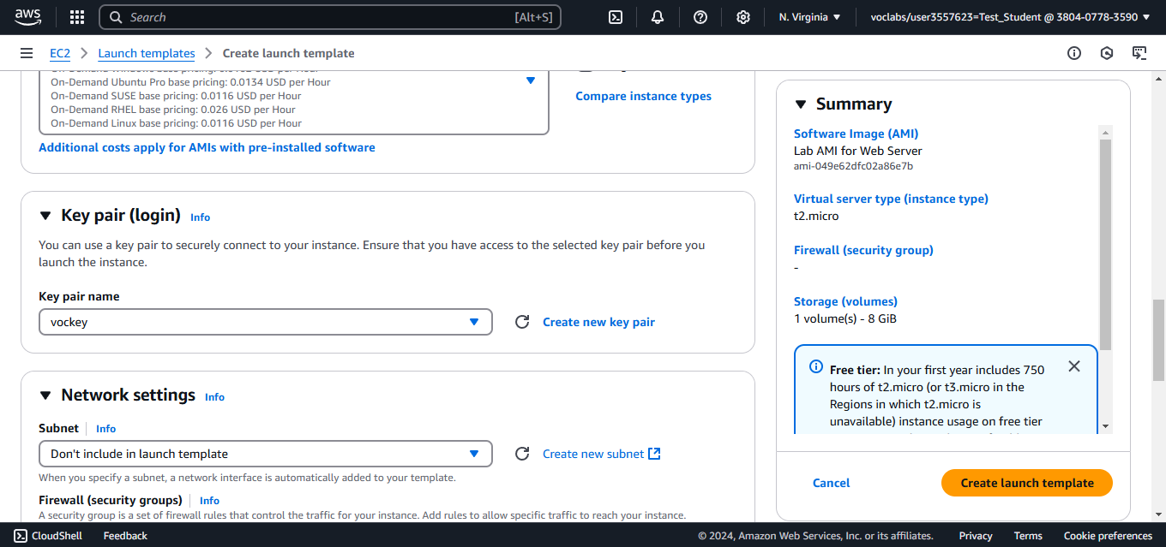
Configure the key pair

Slide 97
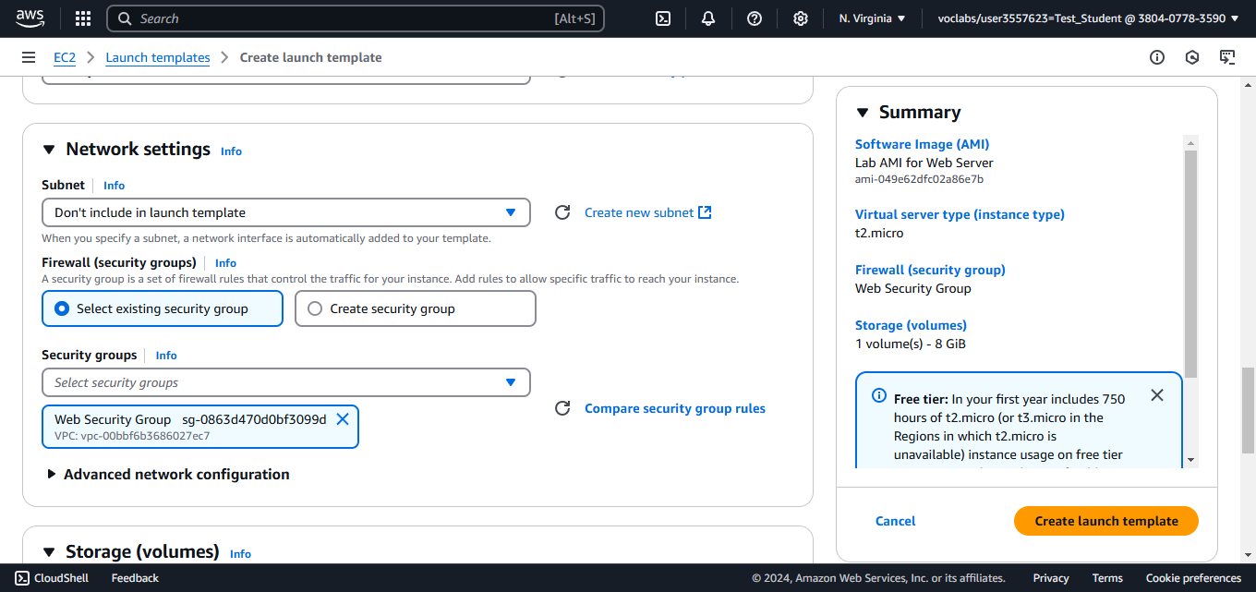
Select the Security Group

Slide 98
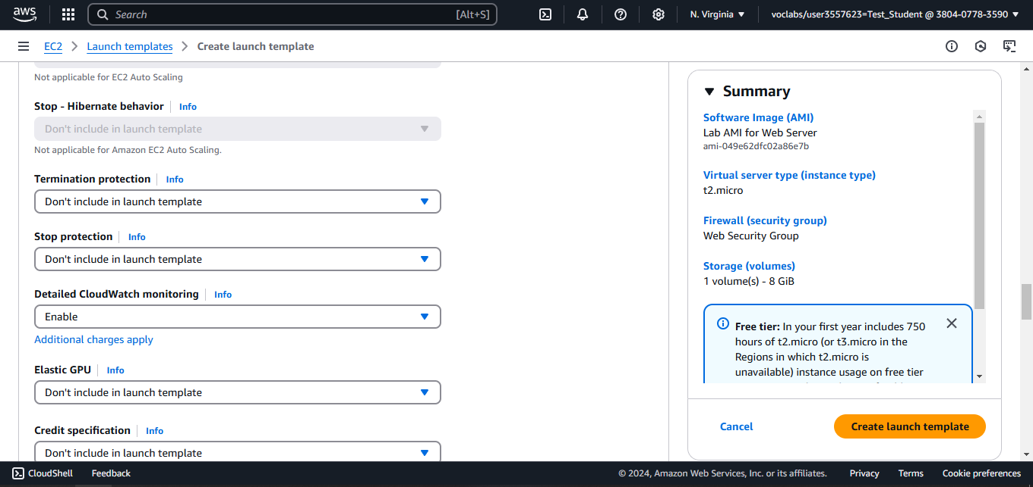
Enable CloudWatch monitoring and create the template

Slide 99
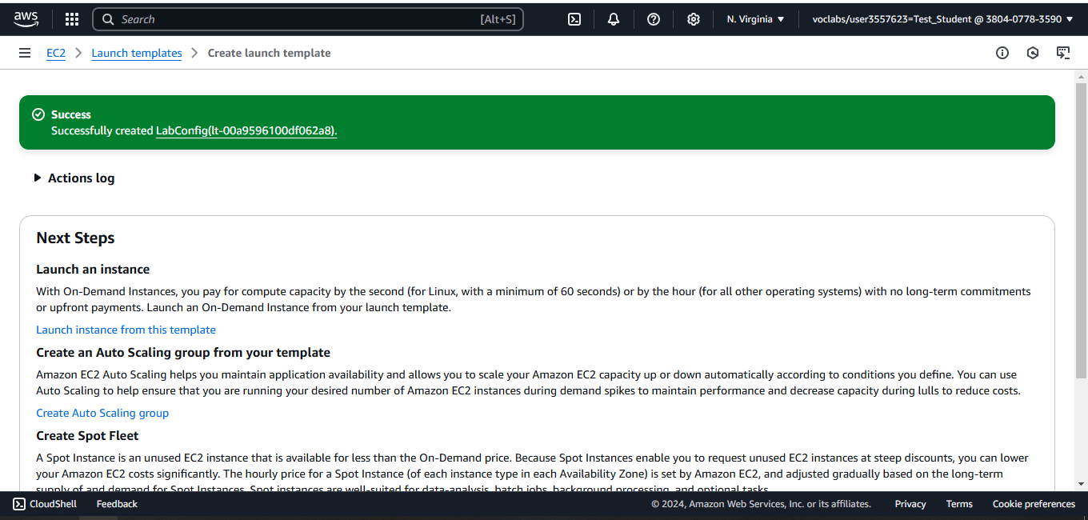
Open the template page

Slide 100

Create Auto Scaling Group from the template

Slide 101

Configure the group name

Slide 102


Slide 103

Configure the VPC and the Subnets

Slide 104

Choose the AZs

Slide 105

Attach a load balancer

Slide 106


Slide 107

Configure the Desired, Min, and Max capacity

Slide 108

Configure a scaling Policy

Slide 109


Slide 110


Slide 111

Add a Tag

Slide 112

Create the Auto Scaling Group

Slide 113

Check the running instances, a new instances have been launched

Slide 114

Check the Targets in the Target Group

Slide 115

Two instances have been added

Slide 116

Copy the DNS name of the load balancer

Slide 117

The web server is working

Slide 118

Search for CloudWatch

Slide 119

Check the two created alarms

Slide 120

The Average CPU utilization of the instances

Slide 121

Increase the load on the Web Servers

Slide 122

After a while, the AlarmHigh Alarm will be “In alarm” state

Slide 123

Check the running instances again

Slide 124

Terminate the Web server 1 instance

Slide 126

Notes:
traceability

Slide 127

Notes:
Assume everything will fail

Slide 128

Notes:
1,3,4

Slide 129

Notes:
2,5

Slide 130

Notes:
3

Slide 131

Notes:
2

Slide 132

Notes:
3

Slide 133

Notes:
3

Slide 134

Notes:
2

Slide 135

Notes:
4

Slide 136
Questions
1- What is the main purpose of High Availability in the Cloud?
Increase scalability
Access on computers and smart phones
Handle greater load by launching EC2 instances based on the demand
Application continuity even in case of disaster
Notes:
D. Application continuity even in case of disaster

Slide 137
Questions
2- Changing an EC2 Instance Type from a t3a.medium to a t3a.2xlarge is an example of?
Horizontal Scaling
High Availability
Agility
Vertical Scaling
Notes:
D. Vertical Scaling

Slide 138
Questions
3- What can you use to handle quickly and automatically the changing load on your websites and applications by adding compute resources?
An Elastic Load Balancer
A bigger instance type
An Auto Scaling Group
Health check on your EC2 instance
Notes:
C. An Auto Scaling Group

Slide 139
Questions
4- Which of the following statements is INCORRECT regarding Auto Scaling Groups?
Replace unhealthy instances
Are cost-effective by running at optimal capacity
Automatically register new instances to a load balancer
Automatically changes the EC2 instances types
Notes:
D. Automatically changes the EC2 instances types

Slide 140
Questions
5- Which of the following statements is NOT a feature of Load Balancers?
Spread load across multiple downstream instances
Handle failures of downstream instances
Back-end Autoscaling
Notes:
C. Back-end Autoscaling

Slide 141
Questions
6- The goal of a load balancer is to ensure that we have a minimum and a maximum number of machines running
True
False
Notes:
B. False

Slide 142


Slide 143


Slide 144

Notes:
2,4

Slide 145

Notes:
1

Slide 146

Notes:
2, 4, 5

Slide 147

Notes:
3

Slide 148

Notes:
1, 3, 5

Slide 149

Notes:
3

Slide 150

Notes:
1,3, 4,

Slide 151

Notes:
2

Slide 152

Notes:
1, 3, 5

Slide 153

Notes:
2, 3, 5

Slide 155

Notes:
3

Slide 156

Notes:
3

Slide 157

Notes:
2

Slide 158

Notes:
1,3

Slide 159

Notes:
4

Slide 160

Notes:
1,5

Slide 161

Notes:
config

Slide 162

Notes:
1

Slide 163

Notes:
4

Slide 164

Notes:
1

Slide 165

Notes:
3

Slide 166

Notes:
3

Slide 167

Notes:
4

Slide 168

Notes:
1

Slide 169

Notes:
4

Slide 170

Notes:
3

Slide 171

Notes:
4

Slide 172

Notes:
3

Slide 173

Notes:
2,4

Slide 174

Notes:
2

